Slide 1
AeroSandbox: Enabling Rapid Aircraft Design Optimization via Automatic Differentiation
Presented by: Peter Sharpe, MIT AeroAstro
Friday, December 9, 2022

Slide 2
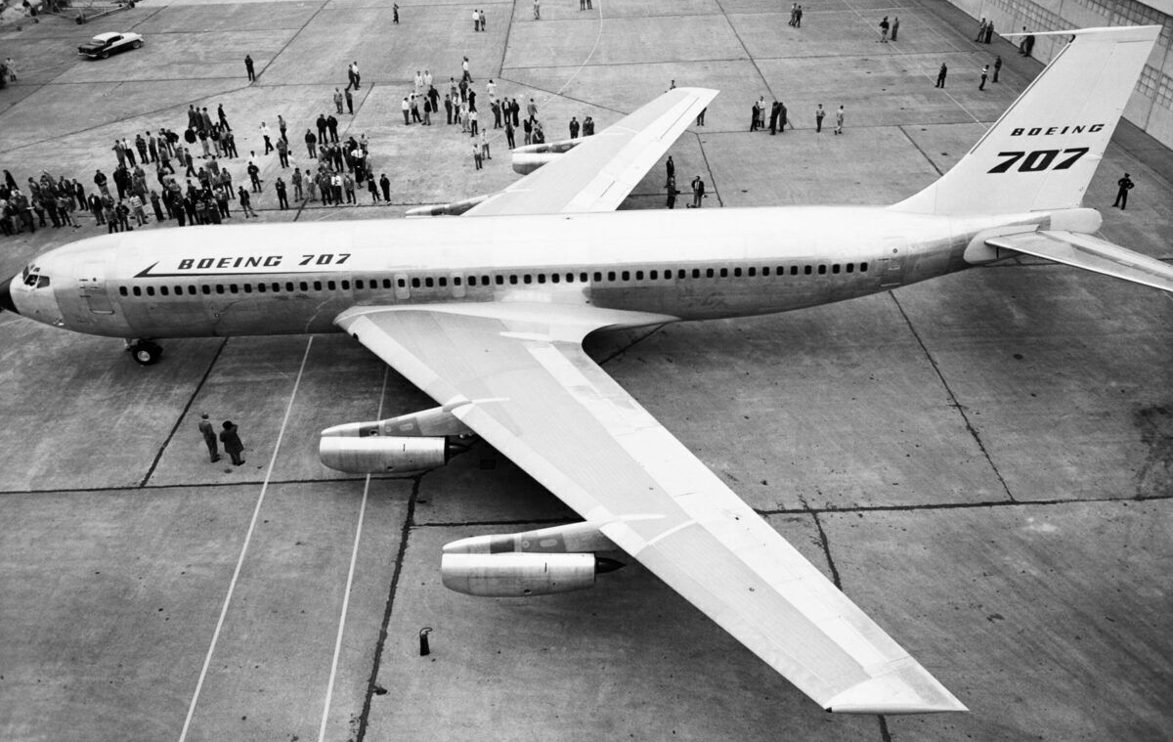
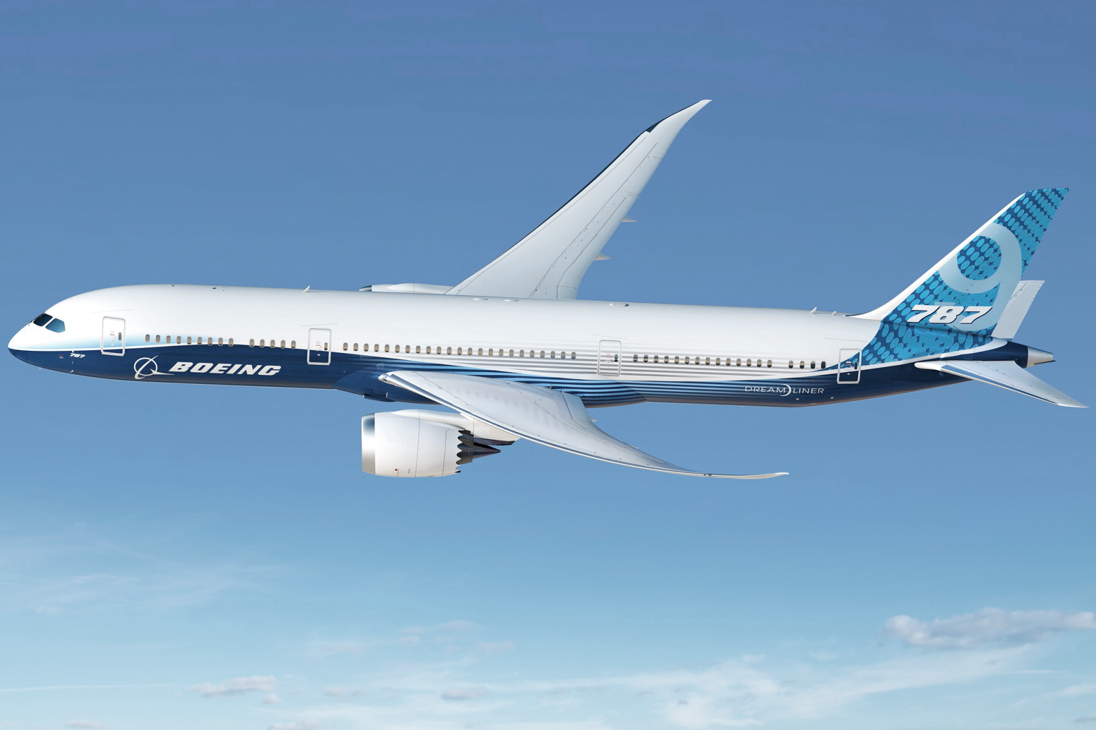
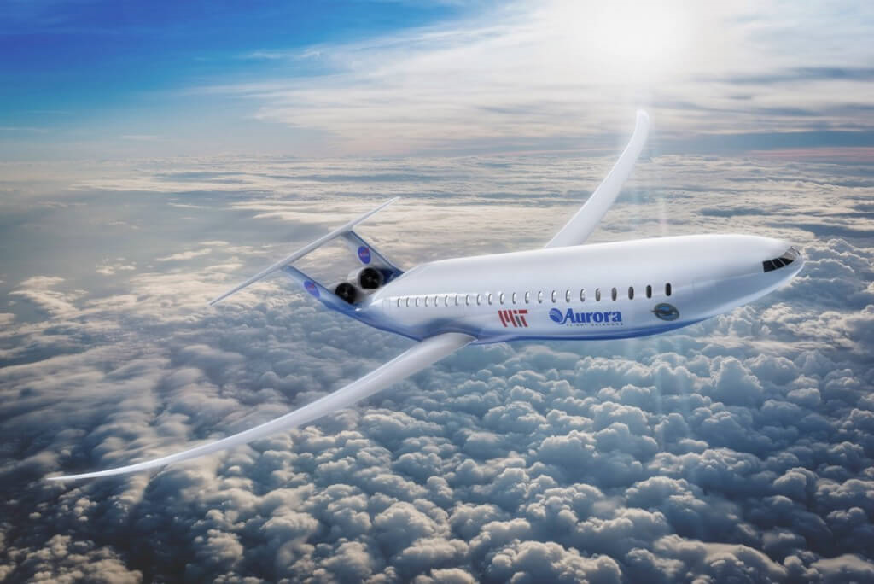
Design Optimization Enables Cheaper, Greener Aircraft
Past: Boeing 707 (1956)
Fuel Efficiency:
45 passenger-miles / gallon
Design mindset:
Satisficing: a decision-making heuristic when mathematical optimization is intractable (Coined by Simon, 1956)
Present: Boeing 787 (2007)
Fuel Efficiency:
120 passenger-miles / gallon
Mostly due to:
Propulsion technology advances
Computational simulation
Optimization mindset throughout subsystem design
Future: Aurora D8 (2035?)
Fuel Efficiency:
160 passenger-miles / gallon
Will be mostly due to:
Multidisciplinary design optimization (MDO): finding synergies between subsystems
Adapted from Drela “Development of the D8 Transport Configuration”, “Making an Extraordinary Machine Better”

Slide 3
What Makes Aircraft Design Optimization So Hard?
Essentially, three factors:
Multidisciplinary, Highly-Coupled Problems
High-Dimensional Optimization
Human-In-The-Loop Iteration

Slide 4
What Makes Aircraft Design Optimization So Hard?
Multidisciplinary, Highly-Coupled Problems
On free-flying aerospace systems:
Every mass, force/moment, and energy must balance against all others
Multifunctional, highly integrated design
So:
Subsystems compete for size, weight, power
All subsystems must be designed together
Aircraft Design Disciplines
Aerodynamics
Structures
Propulsion
Stability & Control
Trajectory / Dynamics
Mission-specific requirements
…
Weights
Power Systems

Slide 5
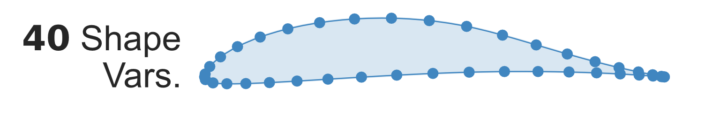
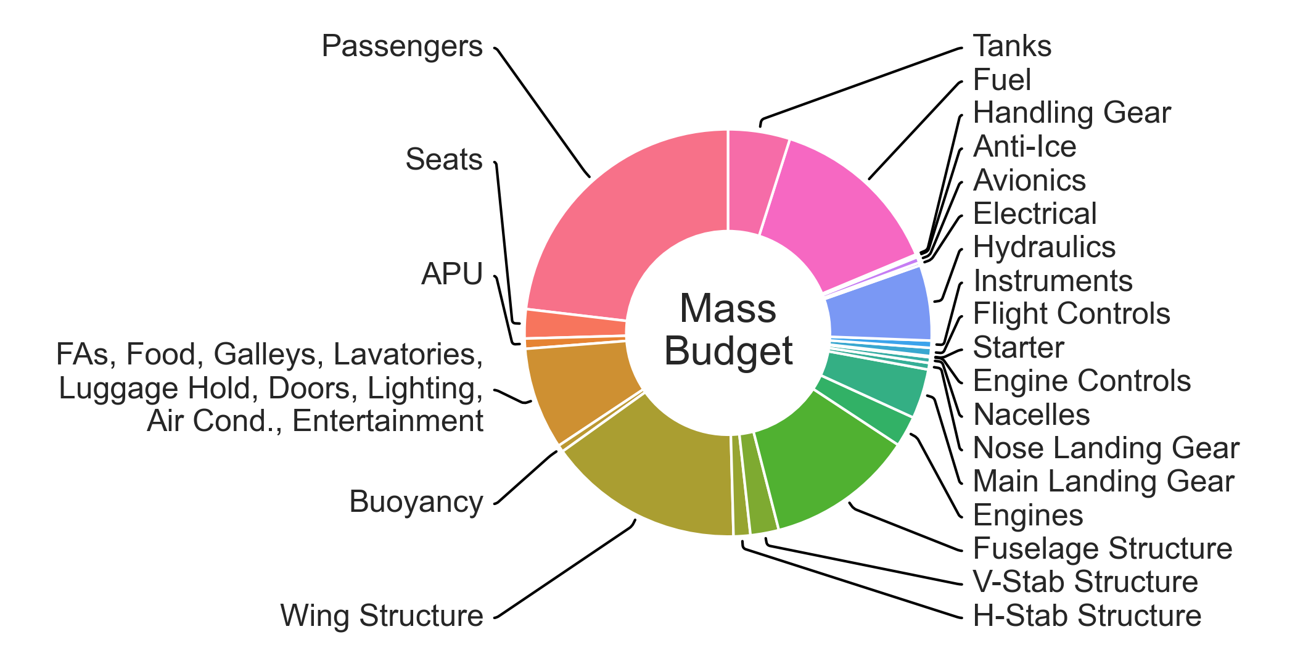
What Makes Aircraft Design Optimization So Hard?
High-Dimensional Optimization
Thousands of decision variables and constraints. Due to:
Shape parameterization
Many subsystems
“Curse of Dimensionality”
Design space “volume” grows exponentially with number of dimensions.
Requires careful algorithmic choices!
Gradient-based optimization is the only tractable approach for large problems.

Slide 6
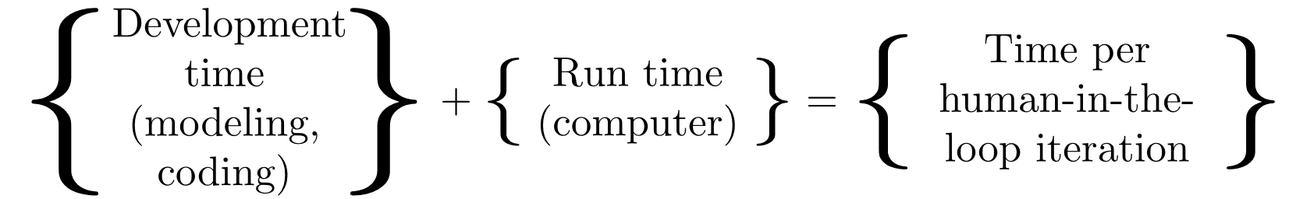
What Makes Aircraft Design Optimization So Hard?
Human-In-The-Loop Iteration
Very difficult to pose the right optimization problem on the first try, even for experts
Optimization is adversarial – modeling flaws will be exploited
Must have a human in the loop to sanity-check
Instead of iterating on the design, you must iterate on the problem
Need a computational optimization framework that minimizes the time to iterate – from whiteboard sketch to results

Slide 7
Modern Optimization Methods help Aircraft Design Massively
Huge advances in computational optimization in the past 25 years
Typically 3 to 6 orders of magnitude faster than traditional methods on practical aircraft design problems
Feature
Primal-dual interior-point solvers
Architecture switching
Automatic differentiation
Automatic sparsity detection
Automatic constraint reordering
Accelerate by exploiting problem structure; need to look at the code
Notes:
Applied math departments have been hard at work

Slide 8
Technical Gap: Modern Optimization Methods Aren’t Accessible to Engineers
Multidisciplinary Design Optimization (MDO) tools commonly used today in Aerospace Industry
Advances largely haven’t made it to industry:
Require users to be subject-matter-experts both in their discipline and in optimization
Gap: an optimization framework that lets non-specialists access advanced techniques
Focus: Ease of use
Feature | OpenMDAO (NASA) | pyMDO | Phoenix ModelCenter | Esteco modeFRONTIER | iSIGHT
Primal-dual interior-point solvers | ✔ | ✔ | ✖ | ✖ | ✖
Architecture switching | ✔ | ✔ | ✖ | ✖ | ✖
Automatic differentiation | ✖ | ✖ | ✖ | ✖ | ✖
Automatic sparsity detection | ✖ | ✖ | ✖ | ✖ | ✖
Automatic constraint reordering | ✖ | ✖ | ✖ | ✖ | ✖
Notes:
Focus of this talk is on how you structure an optimization framework to be easy to use, not on the optimization math – but happy to answer questions here if desired.

Slide 9

Framework Overview
Master’s work:
AeroSandbox, an aircraft design optimization framework that aims to:
Make modern optimization advances accessible to non-specialists
Declarative, not imperative coding
Automated problem transformations for transparency
Minimize code development time in addition to runtime
Lightweight; make abstraction optional
Code details:
Python 3 (pip-installable)
Open-source (MIT license)
GitHub-hosted
Notes:
Targets these challenges:
Highly coupled problems
Very high dimensionality
Time-dependent

Slide 10
Framework Overview
Master’s work:
AeroSandbox, an aircraft design optimization framework that aims to:
Focus on early-stage design exploration of physical systems
Wide, not deep modeling – exploiting the 80/20 rule
Be practical enough to support real-world aircraft development programs
Code details:
Python 3 (pip-installable)
Open-source (MIT license)
GitHub-hosted
Notes:
Targets these challenges:
Highly coupled problems
Very high dimensionality
Time-dependent

Slide 11
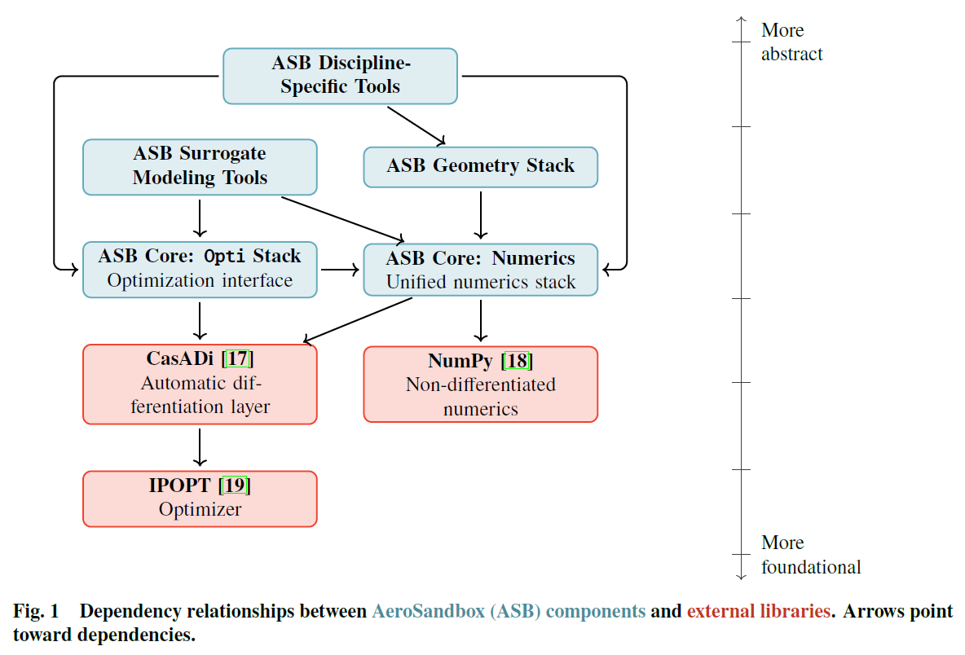
Framework Features
Notes:
Numerics and optimization stack
Aircraft geometry framework (“CAD-lite”)
Dozens of mutually-compatible aerospace physics models
Automatic-differentiable – extremely fast gradients
Surrogate modeling tools to build new models from user data

Slide 12

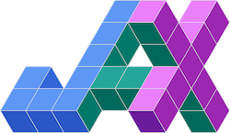
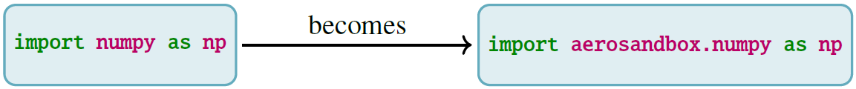
Numerics Stack
Unified numerics module that automatically type-dispatches to appropriate backend, depending on datatype and differentiability needs
Syntax mirrors NumPy exactly:
Most existing Python-based analyses can be used with AeroSandbox by simply editing the NumPy import
Differentiable coverage of nearly all of NumPy, some parts of SciPy

Slide 13
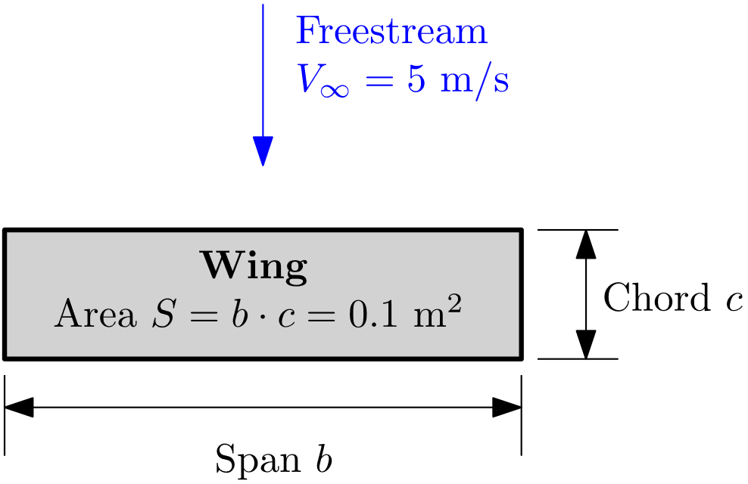
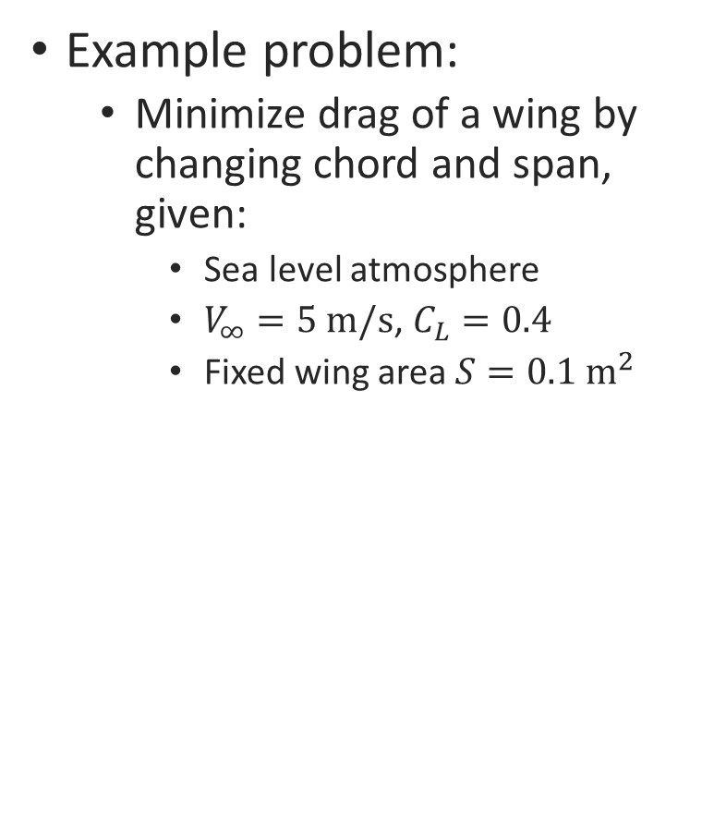
Optimization Stack
Example problem:
Minimize drag of a wing by changing chord and span, given:
Sea level atmosphere
$V_{∞}=5 \text{m}\text{/}\text{s}$, $C_{L}=0.4$
Fixed wing area $S=0.1 {\text{m}}^{2}$
A simple AeroSandbox program
opti = asb.Opti() chord = opti.variable(init_guess=1) span = opti.variable(init_guess=1) Re = velocity * chord / kinematic_viscosity CD_p = 1.328 * Re ** -0.5 AR = span / chord CD_i = CL ** 2 / (pi * AR) opti.subject_to(chord * span == 0.1) opti.minimize(CD_p + CD_i) sol = opti.solve() print(sol.value(chord), sol.value(span))
Make an optimization problem
Make design variables and set initial guesses
Model profile drag
Model induced drag
Constrain the wing area
Set an objective function
Solve
Show results
Imports/constants above
Result: $c=0.066$ m, $b=1.52$ m

Slide 14
Optimization Stack
Declarative, not imperative – a modeling language approach
Numerics are abstracted away
Allows users to focus on asking the right problem
Minimal boilerplate code
Object-oriented, natural syntax
A simple AeroSandbox program
opti = asb.Opti() chord = opti.variable(init_guess=1) span = opti.variable(init_guess=1) Re = velocity * chord / kinematic_viscosity CD_p = 1.328 * Re ** -0.5 AR = span / chord CD_i = CL ** 2 / (pi * AR) opti.subject_to(chord * span == 0.1) opti.minimize(CD_p + CD_i) sol = opti.solve() print(sol.value(chord), sol.value(span))
Make an optimization problem
Make design variables and set initial guesses
Model profile drag
Model induced drag
Constrain the wing area
Set an objective function
Solve
Show results
Imports/constants above
Result: $c=0.066$ m, $b=1.52$ m

Slide 15
Optimization Stack
Backend:
Sensible defaults for optimization settings as applicable to engineering design problems
Automated problem transformations
Variable/constraint scaling, log-transforms, slack variables
Automatic differentiation engine (CasADi or JAX) computes gradient and Hessian
Sparsity detection, Jacobian compression (coloring), constraint re-ordering
IPOPT (optimizer)
A simple AeroSandbox program
opti = asb.Opti() chord = opti.variable(init_guess=1) span = opti.variable(init_guess=1) Re = velocity * chord / kinematic_viscosity CD_p = 1.328 * Re ** -0.5 AR = span / chord CD_i = CL ** 2 / (pi * AR) opti.subject_to(chord * span == 0.1) opti.minimize(CD_p + CD_i) sol = opti.solve() print(sol.value(chord), sol.value(span))
Make an optimization problem
Make design variables and set initial guesses
Model profile drag
Model induced drag
Constrain the wing area
Set an objective function
Solve
Show results
Imports/constants above
Result: $c=0.066$ m, $b=1.52$ m

Slide 16
Case Study: MIT Dawn
Notes:
In the interest of time we skip over further framework implementation details during this brief talk, noting that these are available in the paper.
Next, we present aircraft design examples that illustrate how AeroSandbox can be used in the conceptual aircraft design process.

Slide 17
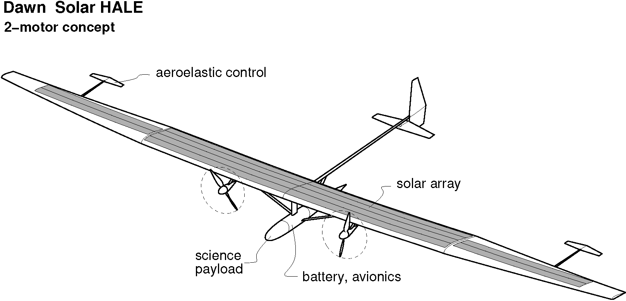
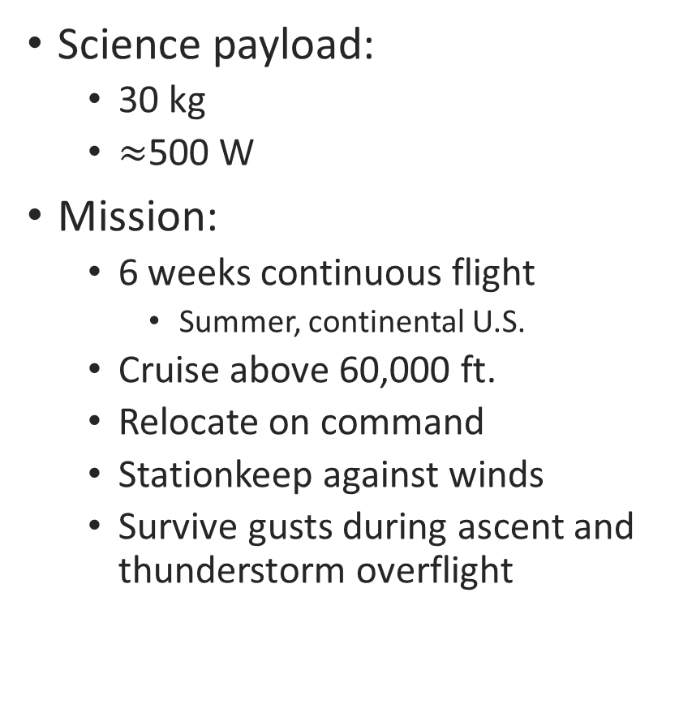
MIT Dawn: Design Problem
Science payload:
30 kg
$≈$500 W
Mission:
6 weeks continuous flight
Summer, continental U.S.
Cruise above 60,000 ft.
Relocate on command
Stationkeep against winds
Survive gusts during ascent and thunderstorm overflight

Slide 18
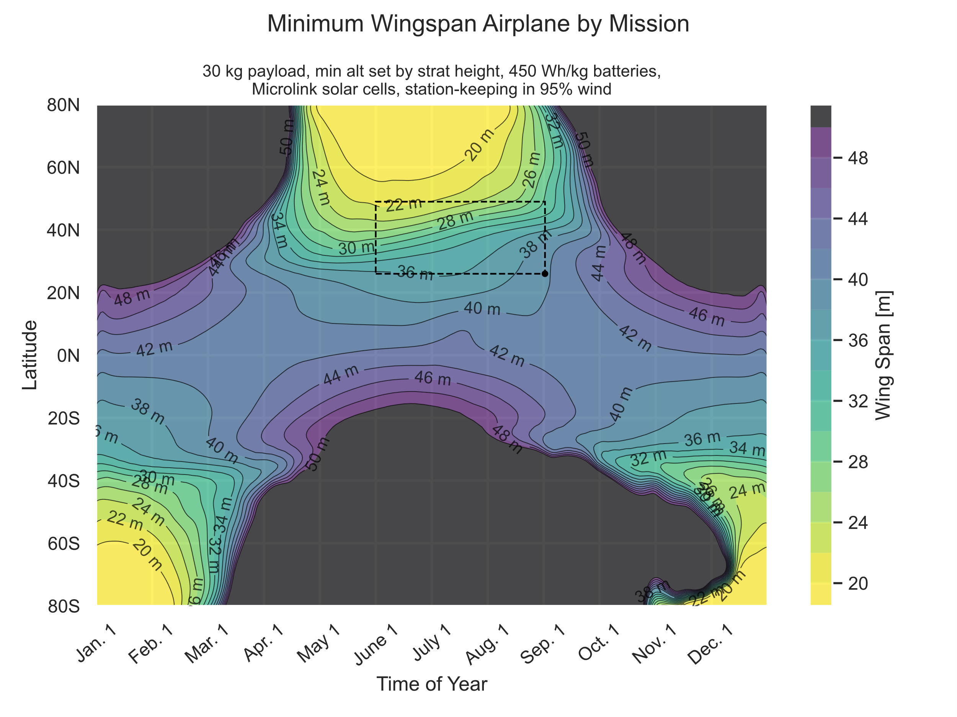
MIT Dawn: Mission Feasibility Maps
A key early question:
“How does the required wingspan vary with latitude and seasonality?”
“Who else should we be pitching to?”
Intuitively, sunny conditions:
expand the space of feasible airplanes
reduce the required wingspan

Slide 19
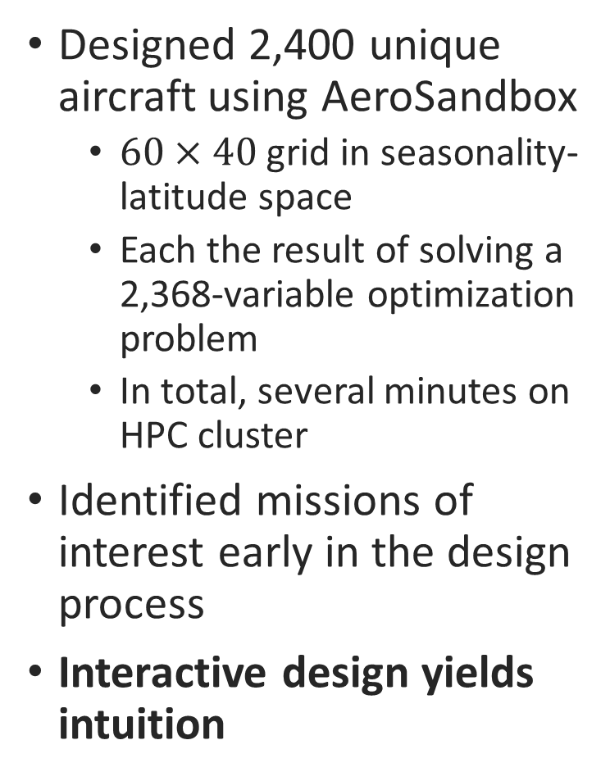
MIT Dawn: Mission Feasibility Maps
Designed 2,400 unique aircraft using AeroSandbox
$60×40$ grid in seasonality-latitude space
Each the result of solving a 2,368-variable optimization problem
In total, several minutes on HPC cluster
Identified missions of interest early in the design process
Interactive design yields intuition
Notes:
This interactivity yields intuition about the design space that supports engineers in developing faster, longer-range, and lower-cost aircraft that do more with less.

Slide 20
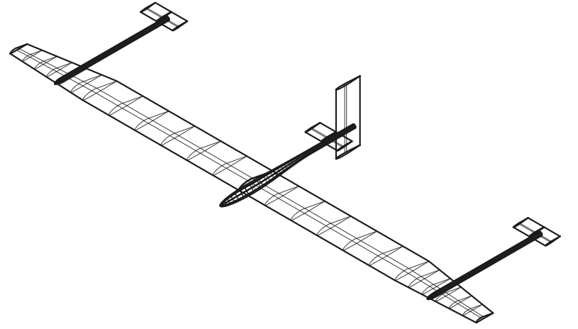
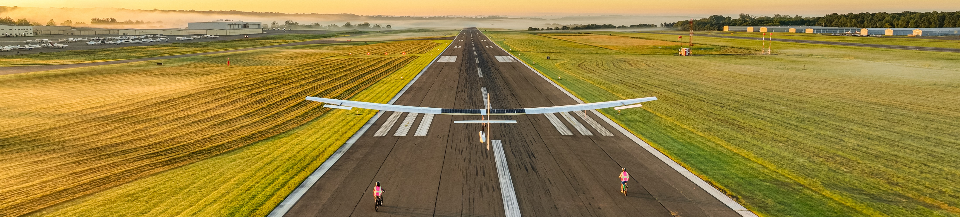
MIT Dawn: Path to Flight
Main design optimization code for Dawn program written in AeroSandbox:
47 seconds to solve
Less than 1600 lines of Dawn-specific code
Supported first flight of 27-meter-wingspan airplane
AeroSandbox Optimization Model (2020)
First Flight (Sept. 2022)

Slide 21
Case Study: MIT Firefly
Notes:
In the interest of time we skip over further framework implementation details during this brief talk, noting that these are available in the paper.
Next, we present aircraft design examples that illustrate how AeroSandbox can be used in the conceptual aircraft design process.

Slide 22
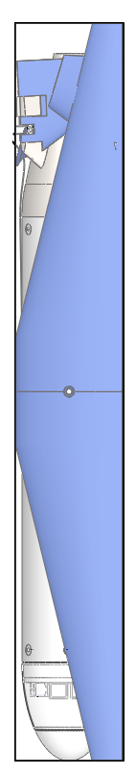
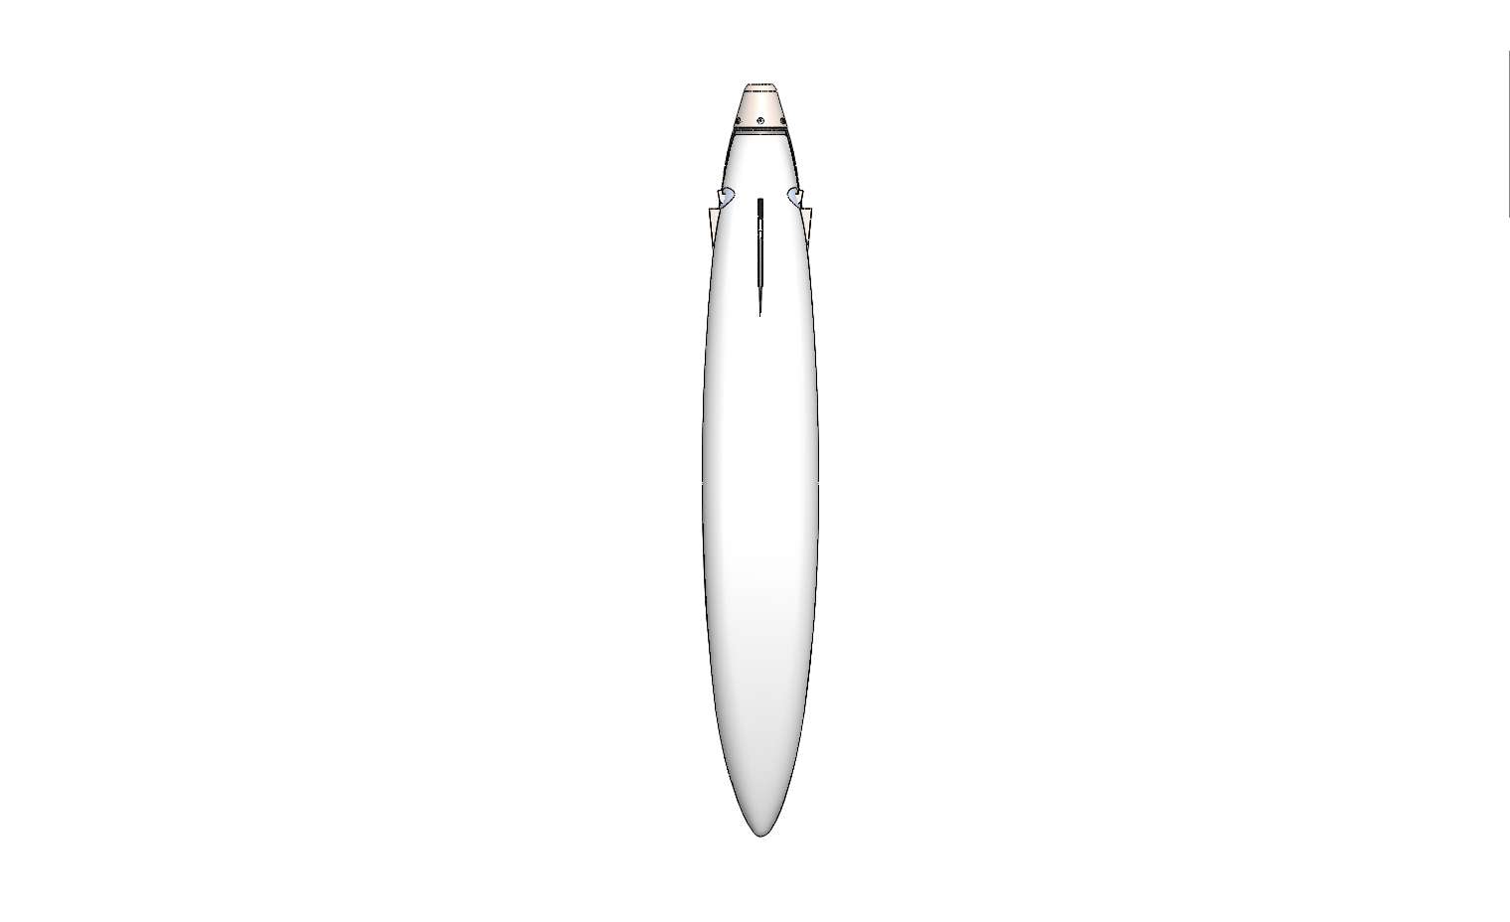
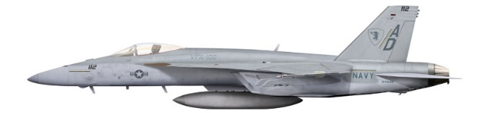
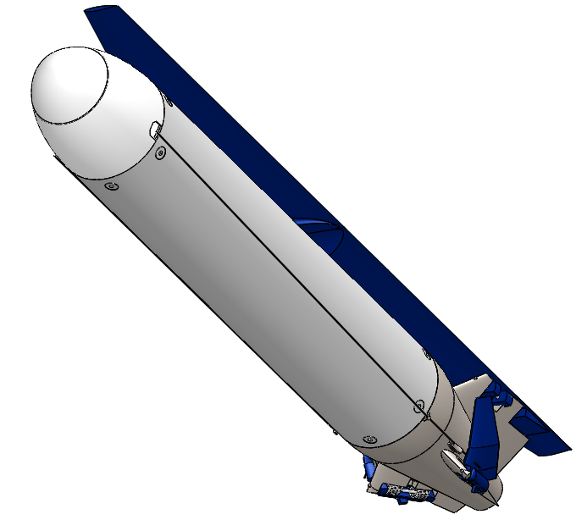
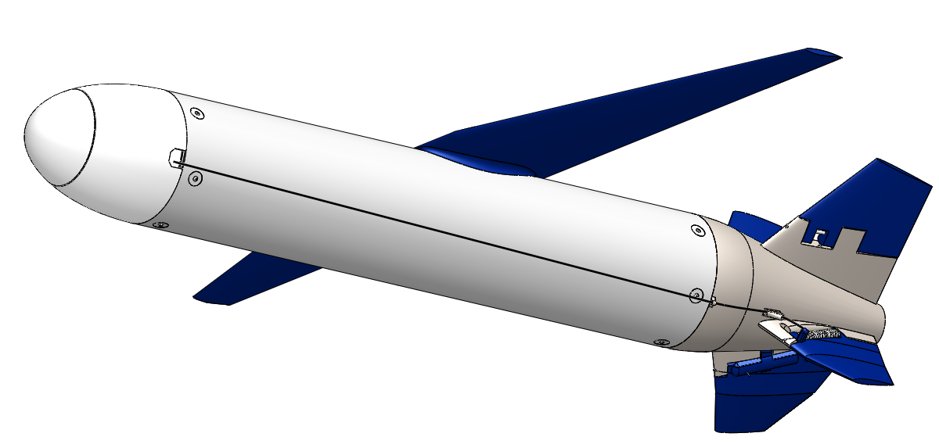
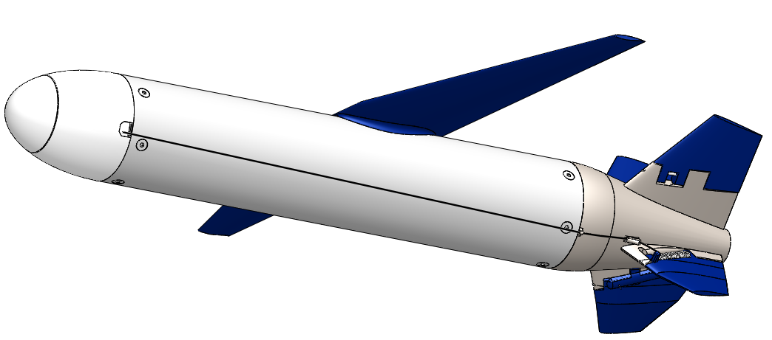
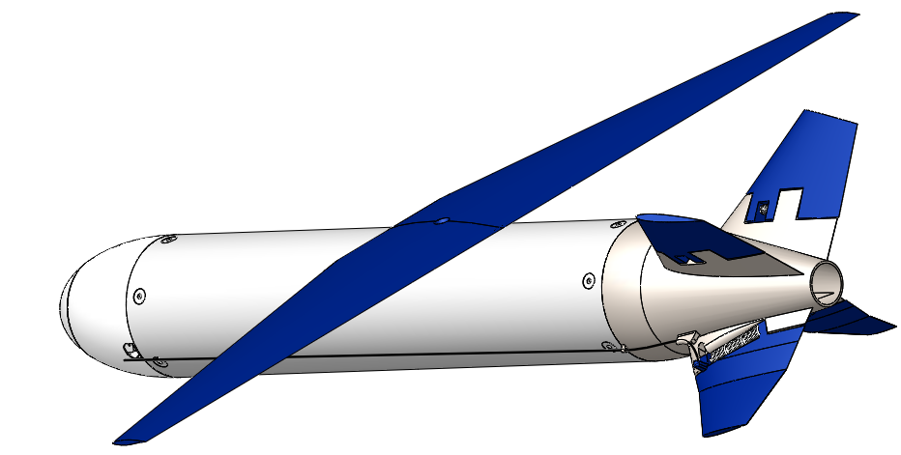
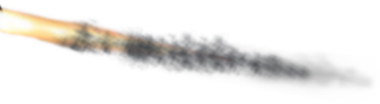
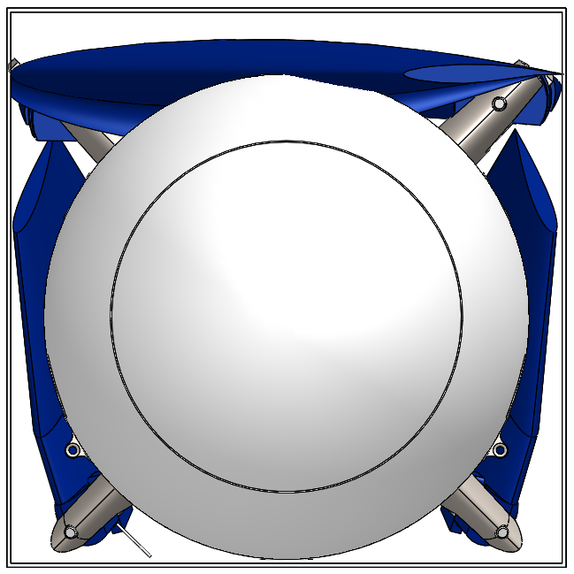
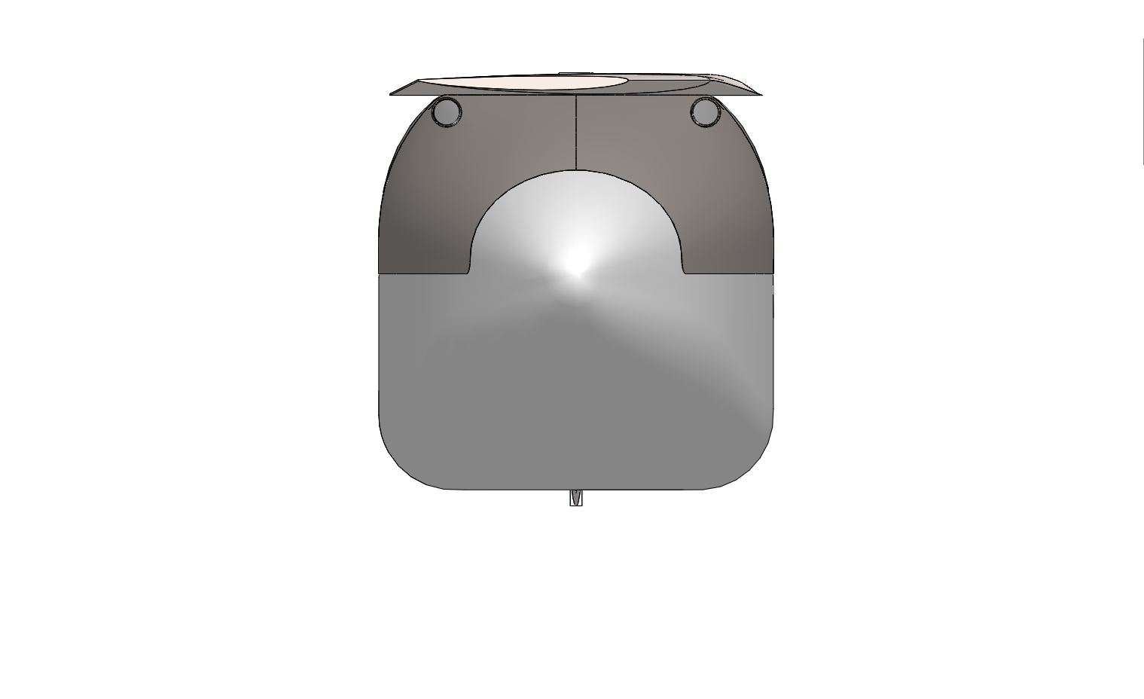
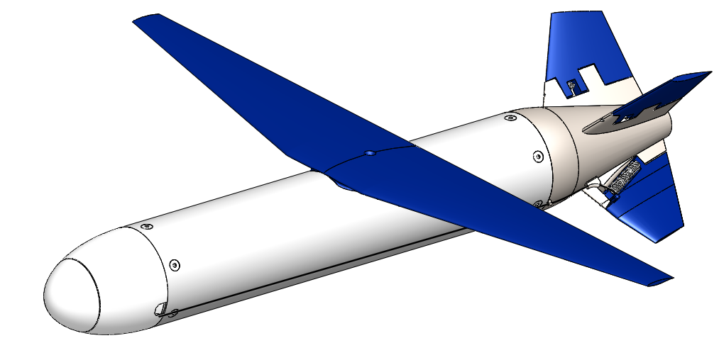
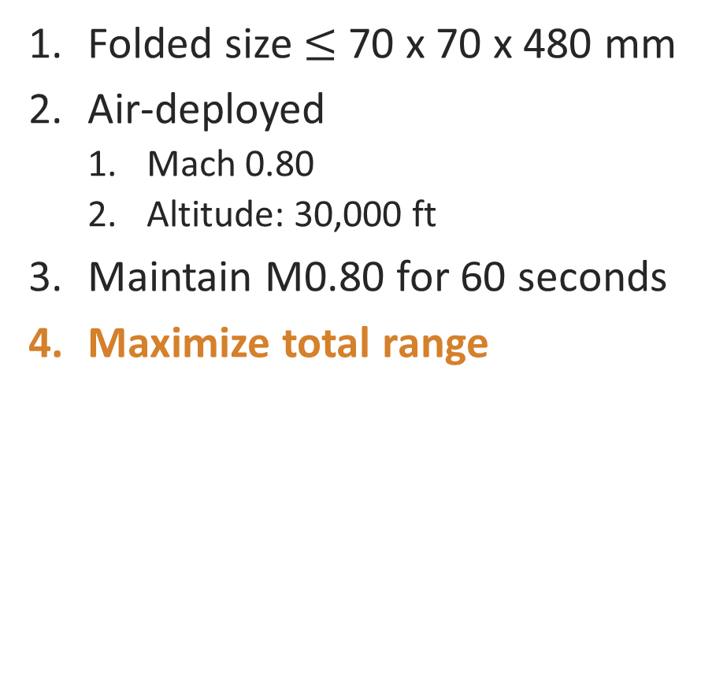
MIT Firefly: Design Problem
Folded size $≤$ 70 x 70 x 480 mm
Air-deployed
Mach 0.80
Altitude: 30,000 ft
Maintain M0.80 for 60 seconds
Maximize total range
480 mm (19.0 in)
Drop
Unfold and stabilize
Powered flight
70 mm (2.75 in)
Glide
Ignite rocket
Disposal
Firefly CAD renders: Julia Gaubatz, MIT
F/A-18 Image: McDonnell Douglas
Notes:
Building upon previous lab work re: micro-UAVs

Slide 23
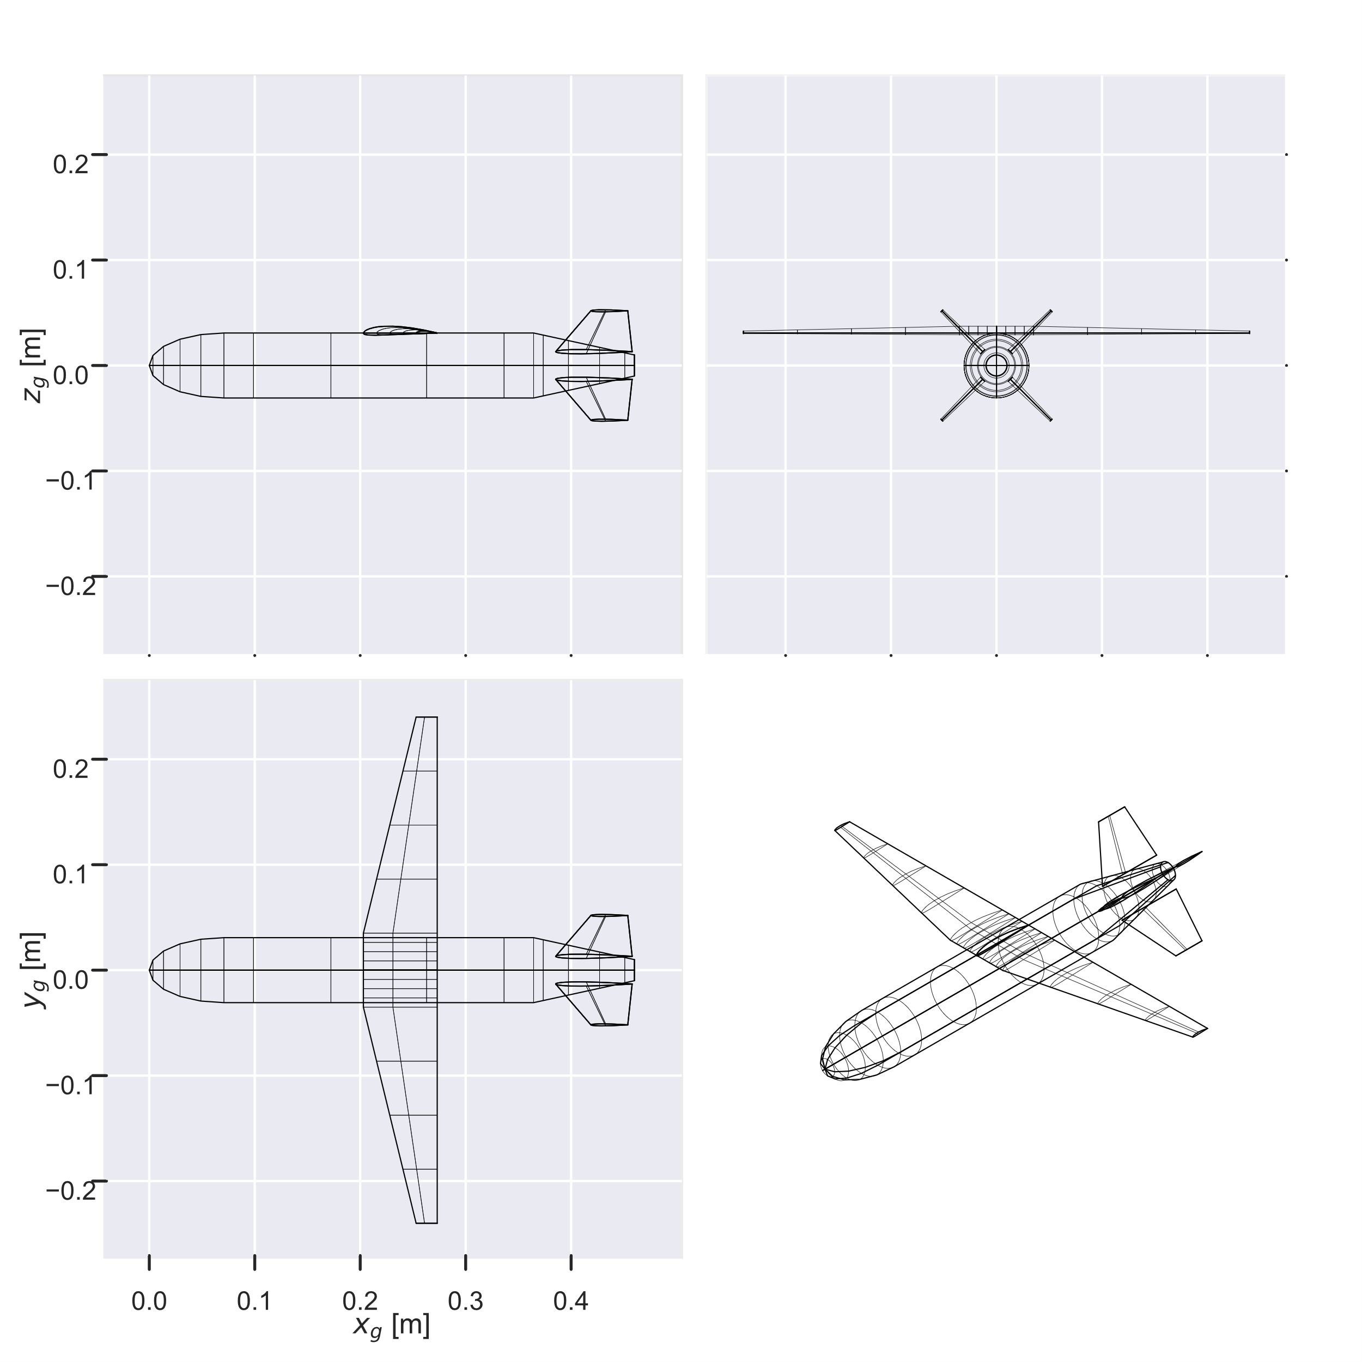
MIT Firefly: Optimization Model
6 coupled disciplines
Aerodynamics
Structures & Mass Properties
Stability & Control
Propulsion
Trajectory / Dynamics
Volume accounting / Packaging
Optimization problem:
3,910 variables, 8,420 constraints
Nonlinear, nonconvex
Modeled with AeroSandbox
Optimized result, visualized with ASB geometry engine
Notes:
6.9 seconds to solve on a laptop.
<600 lines of code to implement; due to plug-and-play models
This is really the more important thing:
Less than an hour from whiteboard sketch (“Will this configuration work?”) to an optimized answer

Slide 24
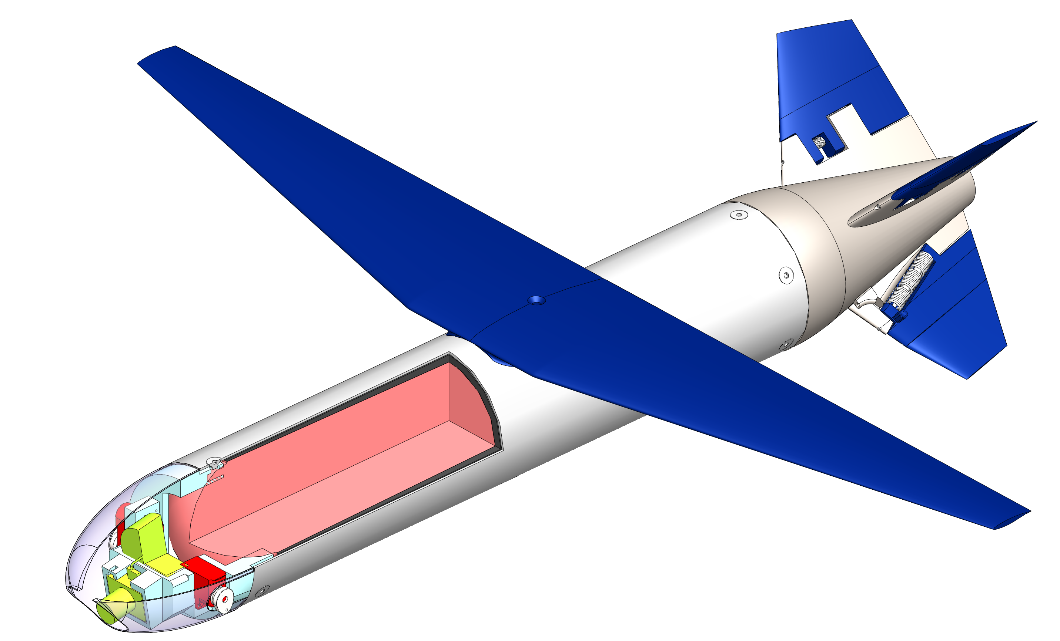
MIT Firefly: Optimization Results
6.9 seconds to solve on a laptop.
Less than 600 lines of Firefly-specific code to implement
Multidisciplinary design optimization increased flight range from 82 km to 244 km
Actuated Tail Control Surfaces
Folding Wing
Motor case (Ti alloy)
Payload
Propellant
Ablative liner
Optimized result, visualized with ASB geometry engine
Servos
Notes:
6.9 seconds to solve on a laptop.
<600 lines of code to implement; due to plug-and-play models
This is really the more important thing:
Less than an hour from whiteboard sketch (“Will this configuration work?”) to an optimized answer

Slide 25
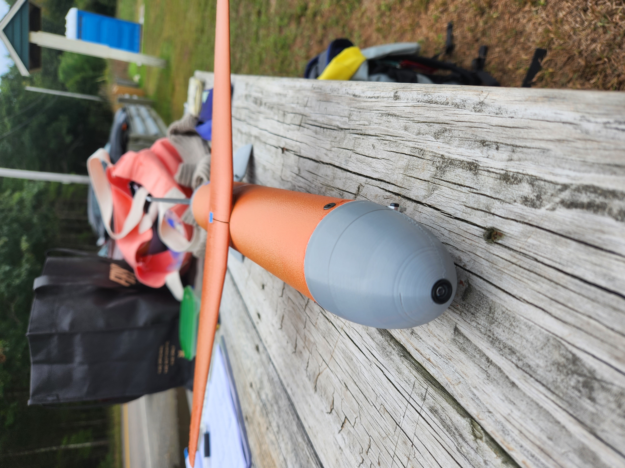
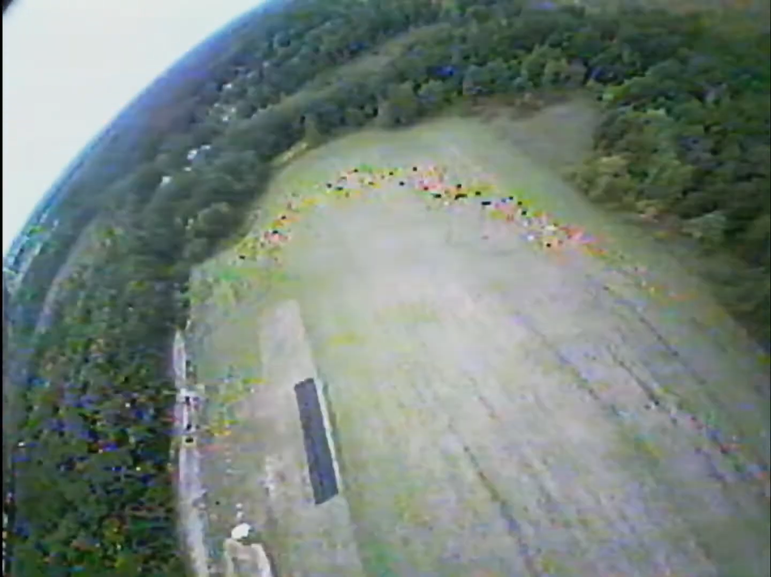
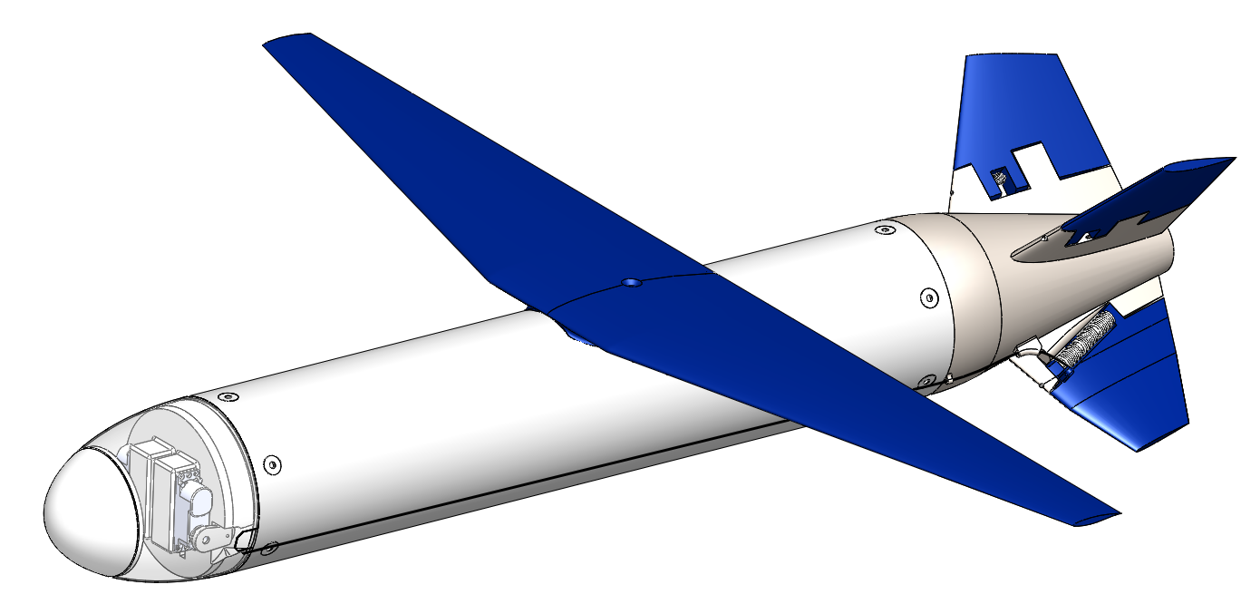
MIT Firefly: Path to Flight
AeroSandbox Optimization Model
Real-World Flight Test Campaign
Detailed Design

Slide 26
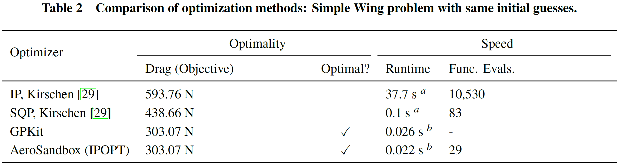
Does AeroSandbox Achieve its Goal?
Is it fast to run a design problem?
Yes – benchmarks favorably against specialized approaches.
Is it fast to implement a design problem?
Hard to quantitatively measure, but the proof is in the pudding:
Significant industry demand: 560,000 downloads (Dec. 2022)
Most-starred aircraft design library on GitHub
Back-compatible with NumPy – shallow learning curve

Slide 27
Key Take-Aways
Modern optimization methods can significantly accelerate aircraft design
AeroSandbox makes these methods accessible to non-specialists
Makes aircraft design optimization both:
Fast to run
Fast to implement
Reducing barriers to optimization supports engineers in developing faster, longer-range, and lower-cost aircraft that do more with less.
Notes:
Basis for:
MIT:
Firefly
Dawn
SSTOL
Rocket re-entry
Student design teams
Outside MIT:
AIAA papers from several universities
At least one homebuilt airplane

Slide 28
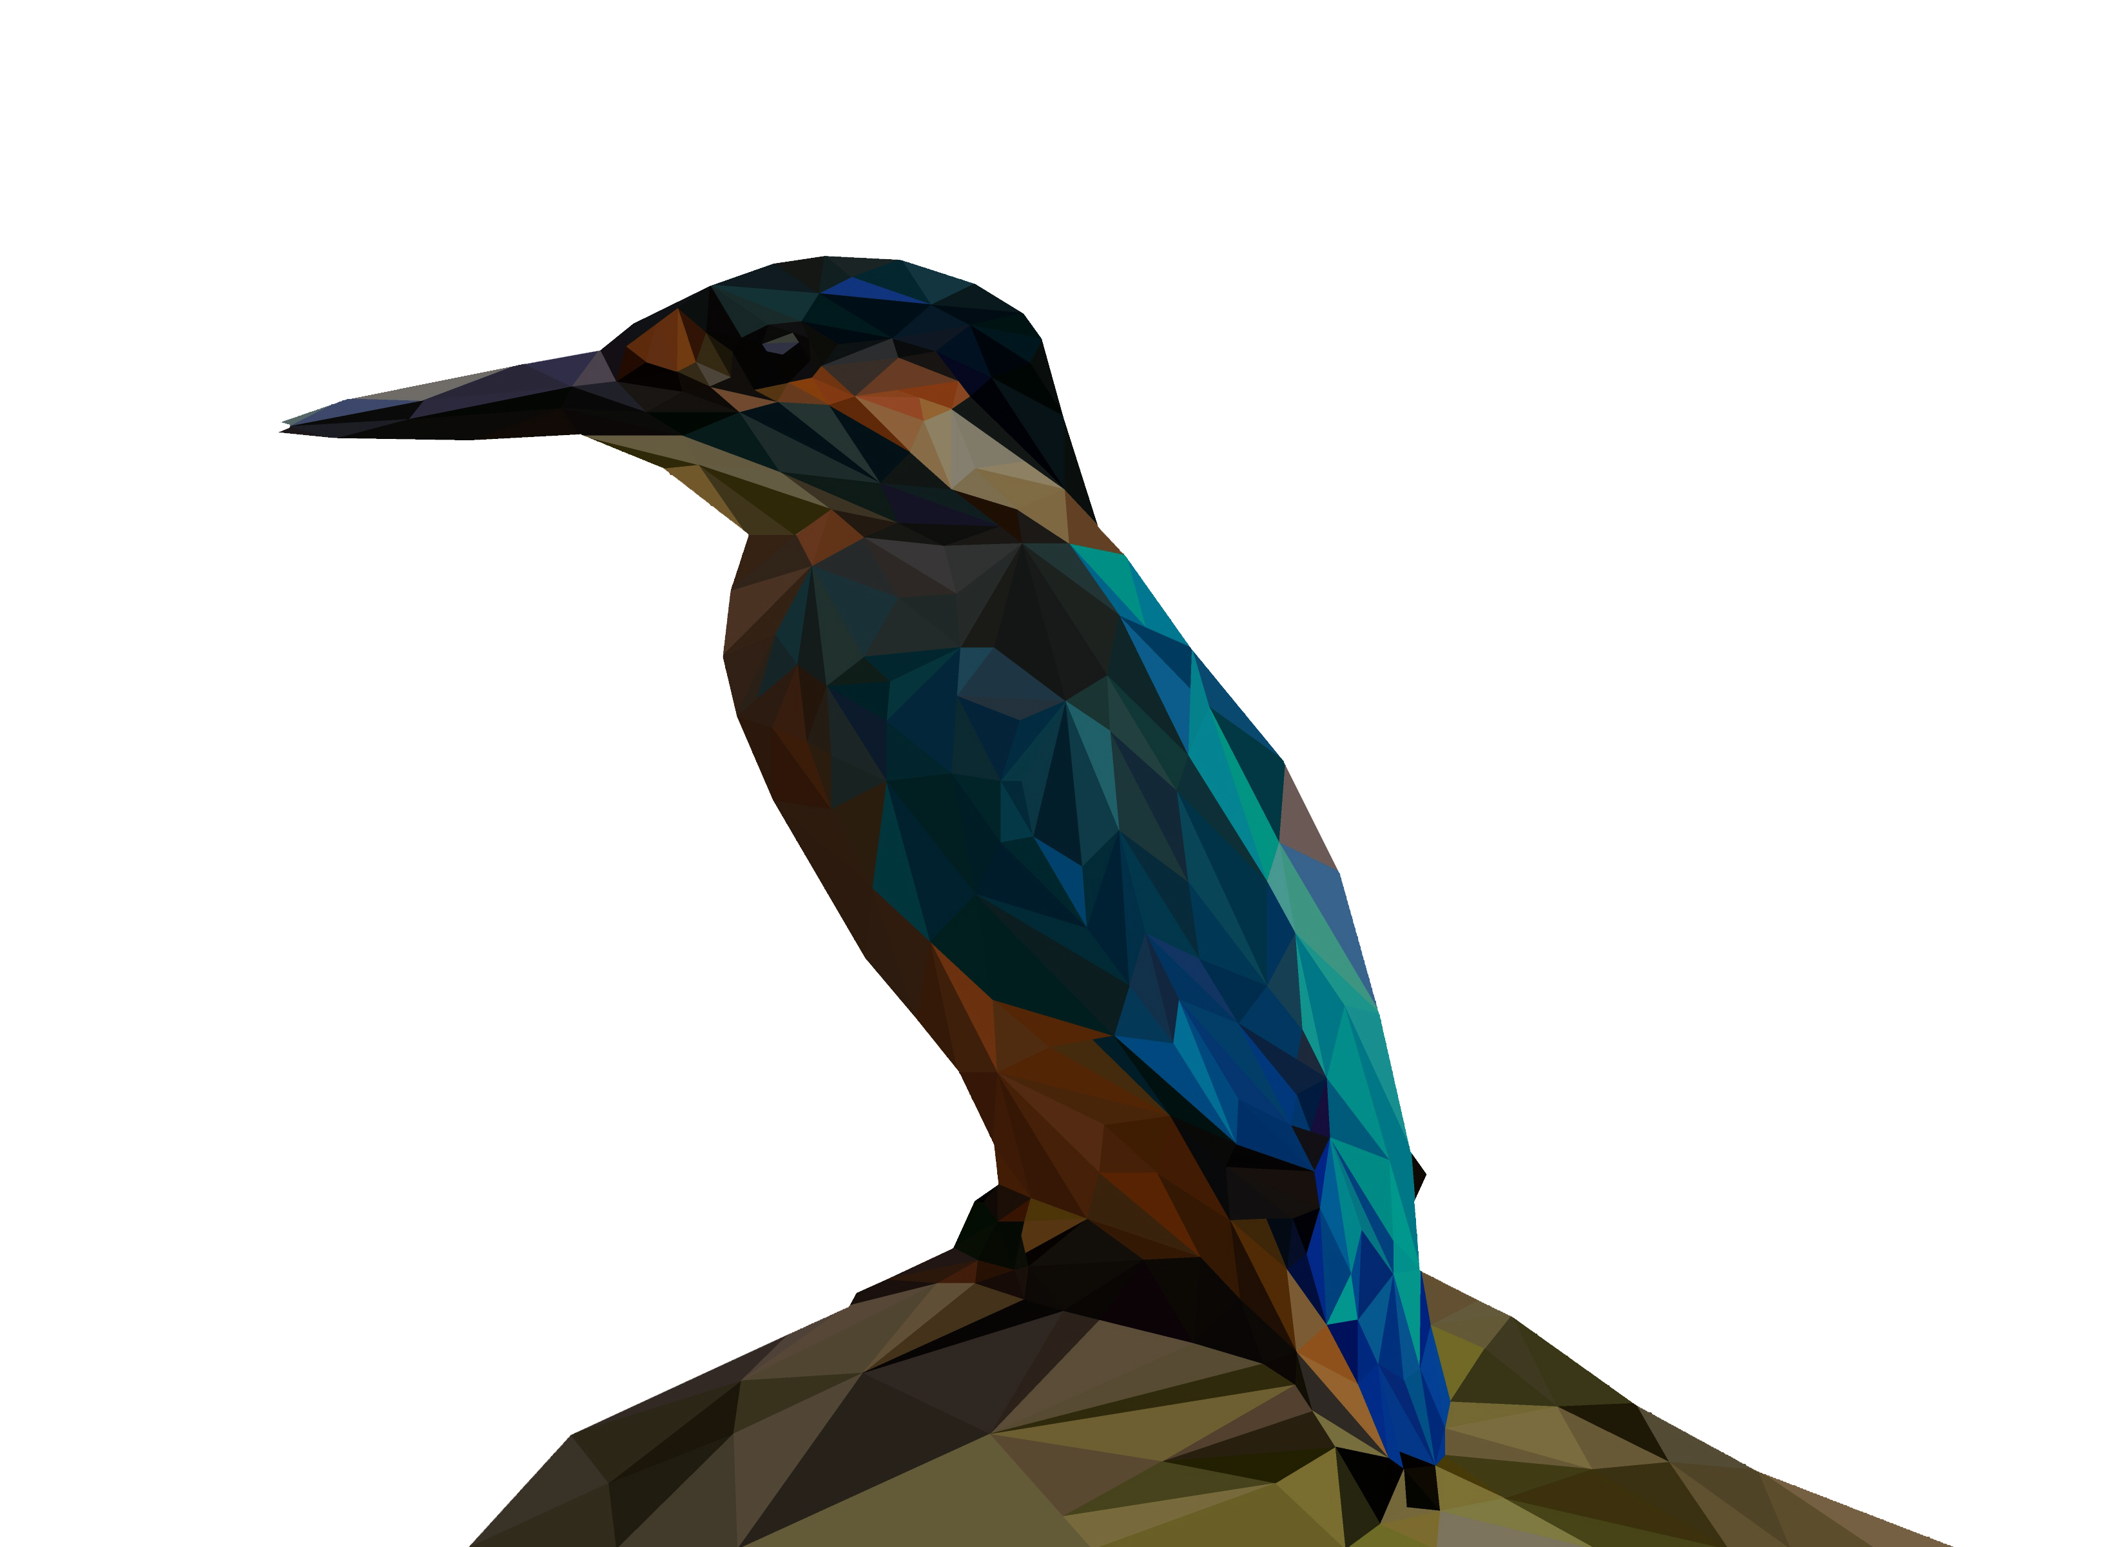
Thank you! Code: github.com/peterdsharpe/AeroSandbox Correspondence: pds@mit.edu

Slide 29
Backup

Slide 30
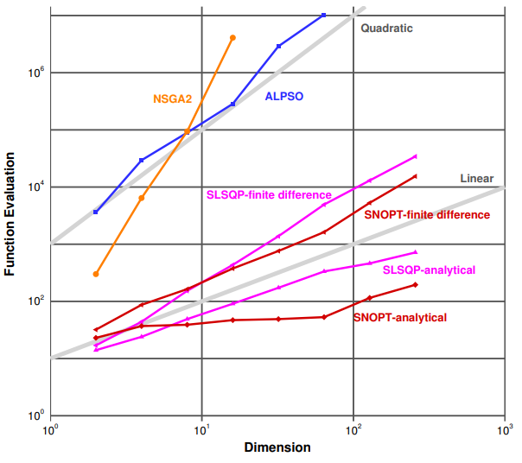
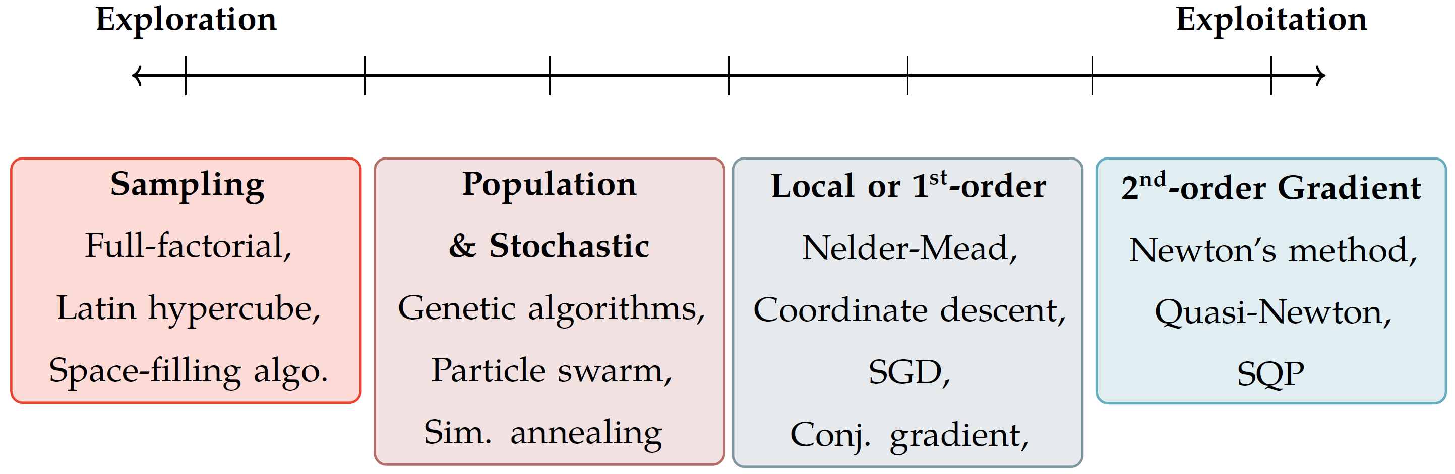
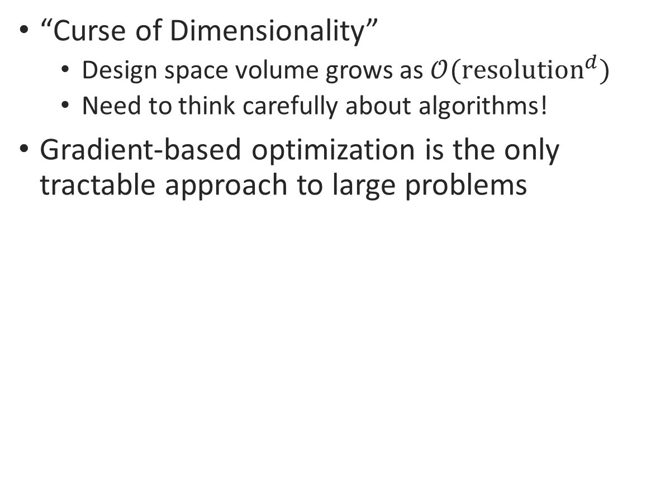
High Dimensionality: Implications for Optimization
“Curse of Dimensionality”
Design space volume grows as $𝒪({\text{resolution}}^{d})$
Need to think carefully about algorithms!
Gradient-based optimization is the only tractable approach to large problems
Dimensionality vs. Computational Cost
Figure reproduced from J. Martins, 2013 pres., “A Very Short Course on Multidisciplinary Design Optimization”
Notes:
Curse of Dimensionality
Imagine an n-dimensional problem, and assume each variable has three settings – low, med, high.
The number of possible designs grows like 3^n – it runs away from us extremely quickly
Clearly sweeping whole the space is out of the question.
Gradient-based
It turns out that gradient-based optimization is really the only tractable approach here
Second-order
So we look at both the Jacobian and Hessian
Automatic differentiation
On chart: analytical derivatives (similar to automatic differentiation) scale sublinearly with dimensionality
With efficient derivatives, you can actually solve n-dimensional optimization problems in fewer than n function evaluations
Something interesting to think about
“Automatic” part vs. analytical derivatives
You don’t have to think about these derivatives
It all happens under the hood
Kind of a theme here: we’re trying to abstract away all the optimization numerics so that you can focus on:
Asking the right questions
(equally importantly) Writing the right physics models

Slide 31
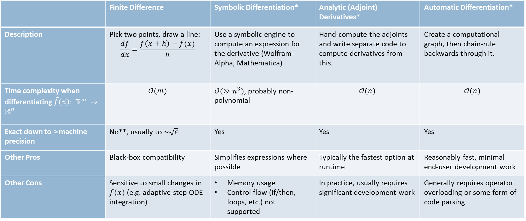
Backup: A Comparison of Gradient Methods
Method
 | Finite Difference | Symbolic Differentiation* | Analytic (Adjoint) Derivatives* | Automatic Differentiation*
Description | Pick two points, draw a line: $$\frac{df}{dx}=\frac{f\left(x+h\right)−f(x)}{h}$$ | Use a symbolic engine to compute an expression for the derivative (Wolfram-Alpha, Mathematica) | Hand-compute the adjoints and write separate code to compute derivatives from this. | Create a computational graph, then chain-rule backwards through it.
Time complexity when differentiating $\vec{f}\left(\vec{x}\right): ℝ^{m} →ℝ^{n}$ | $$𝒪(m)$$ | $𝒪(≫n^{3})$, probably non-polynomial | $$𝒪(n)$$ | $$𝒪(n)$$
Exact down to $≈$machine precision | No**, usually to $\sim \sqrt{ε}$ | Yes | Yes | Yes
Other Pros | Black-box compatibility | Simplifies expressions where possible | Typically the fastest option at runtime | Reasonably fast, minimal end-user development work
Other Cons | Sensitive to small changes in $f(x)$ (e.g. adaptive-step ODE integration) | Memory usage Control flow (if/then, loops, etc.) not supported | In practice, usually requires significant development work | Generally requires operator overloading or some form of code parsing
Figure of Merit
* Unfortunately, the names associated with different methods are not universally accepted by all fields – however, the names listed here reflect dominant trends.
** Complex-step finite differencing or higher-precision arithmetic can alleviate the accuracy issue, but these options are even slower and may not be as supported by numerical libraries.
Notes:
Consider dropping the last two rows

Slide 32
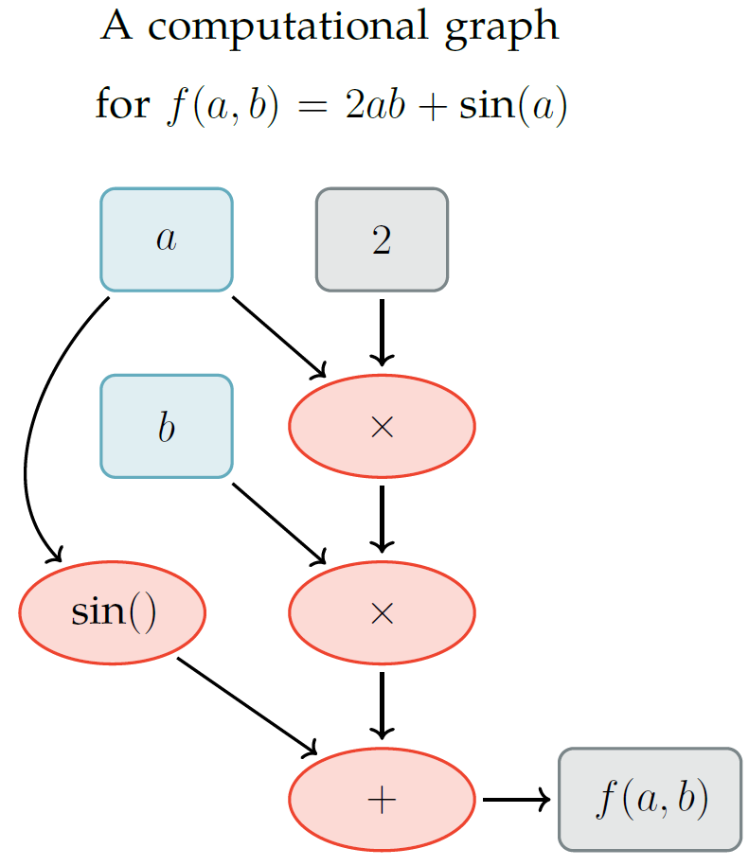
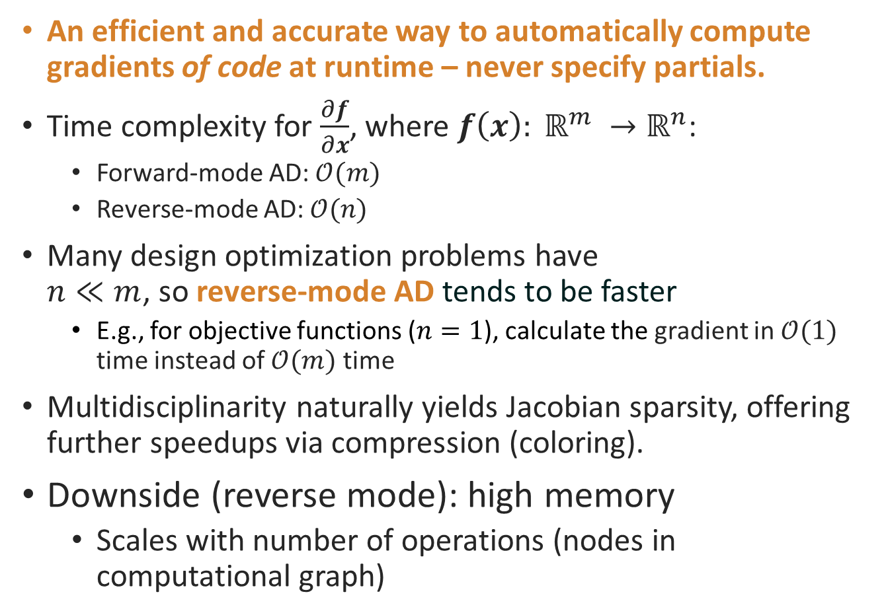
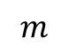
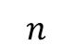
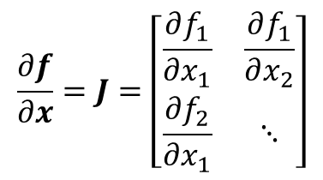
Automatic Differentiation (AD)
$$m$$
An efficient and accurate way to automatically compute gradients of code at runtime – never specify partials.
Time complexity for $\frac{∂f}{∂x}$, where $f\left(x\right): ℝ^{m} →ℝ^{n}$:
Forward-mode AD: $𝒪(m)$
Reverse-mode AD: $𝒪(n)$
Many design optimization problems have $n≪m$, so reverse-mode AD tends to be faster
E.g., for objective functions ($n=1$), calculate the gradient in $𝒪(1)$ time instead of $𝒪(m)$ time
Multidisciplinarity naturally yields Jacobian sparsity, offering further speedups via compression (coloring).
Downside (reverse mode): high memory
Scales with number of operations (nodes in computational graph)
$$\frac{∂f}{∂x}=J=\left[\begin{matrix}\frac{∂f_{1}}{∂x_{1}} & \frac{∂f_{1}}{∂x_{2}} \\ \frac{∂f_{2}}{∂x_{1}} & ⋱\end{matrix}\right]$$
$$n$$
Notes:
Here, we briefly review automatic differentiation, which is one of the way that the Opti stack accelerates optimization.
Automatic differention (or AD) is a way to compute gradients of code.
For a vector-valued function that maps from RM to RN.
AD in Neural Networks:
Neural networks: invented in the 1940s, explored extensively in the 70s
Abandoned until ~2010, when someone figured out how to do AD on GPUs
AD in optimal control:
Trajectory optimization, model predictive control
Boston Dynamics robots, SpaceX landings – both using flavors of AD (though a different kind of optimization)
For a function:
Accuracy figures assuming:
double precision floating point arithmetic
nonlinear functions with normalized curvature
best possible step size for finite-difference
If people are more curious, I have some extra charts with a simple AD example – we’ll skip for time, but happy to talk through at the end

Slide 33
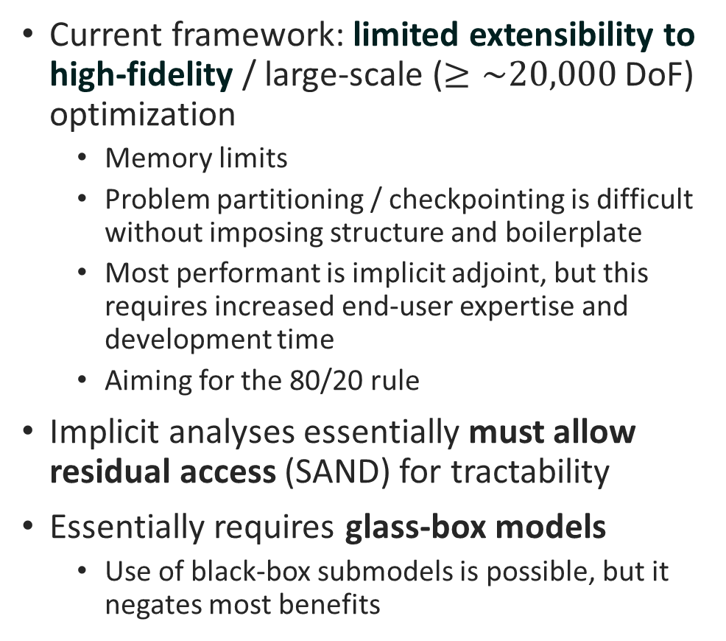
Pros and Cons of an AD-Centric MDO Framework
Pros
Cons
Very low barrier to entry for non-specialists
Re-use of existing analysis code via overloaded, dispatching numerics
Speed (both development and runtime) supports interactive design
Can quickly formulate sizing studies to support configuration decisions
Powerful for clean-sheet conceptual design, feasibility analysis of new concepts
Declarative coding offers a pathway to supercharge user code. JAX transforms:
Backend-agnostic computing (GPU)
Automatic vectorization
Automatic parallelization
Current framework: limited extensibility to high-fidelity / large-scale ($≥\sim 20,000$ DoF) optimization
Memory limits
Problem partitioning / checkpointing is difficult without imposing structure and boilerplate
Most performant is implicit adjoint, but this requires increased end-user expertise and development time
Aiming for the 80/20 rule
Implicit analyses essentially must allow residual access (SAND) for tractability
Essentially requires glass-box models
Use of black-box submodels is possible, but it negates most benefits

Slide 34
Robustness: Simple Wing & Simple Airplane
Problem is solved to known optimum in 22 milliseconds.
Robustness to initial guesses:
In practice, significantly less of a concern than one might initially expect.
Due to automated problem transformations, exact gradients, and IPOPT backtracking
In this case, we demonstrate convergence if variables are initialized to within two orders of magnitude of the optimum.

Slide 35
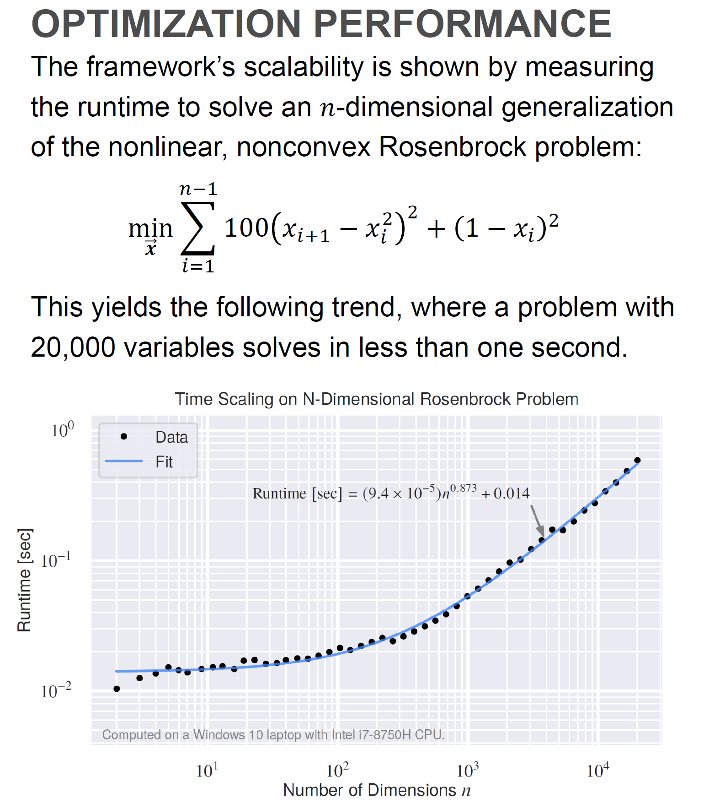
Optimization Performance of AeroSandbox

Slide 36
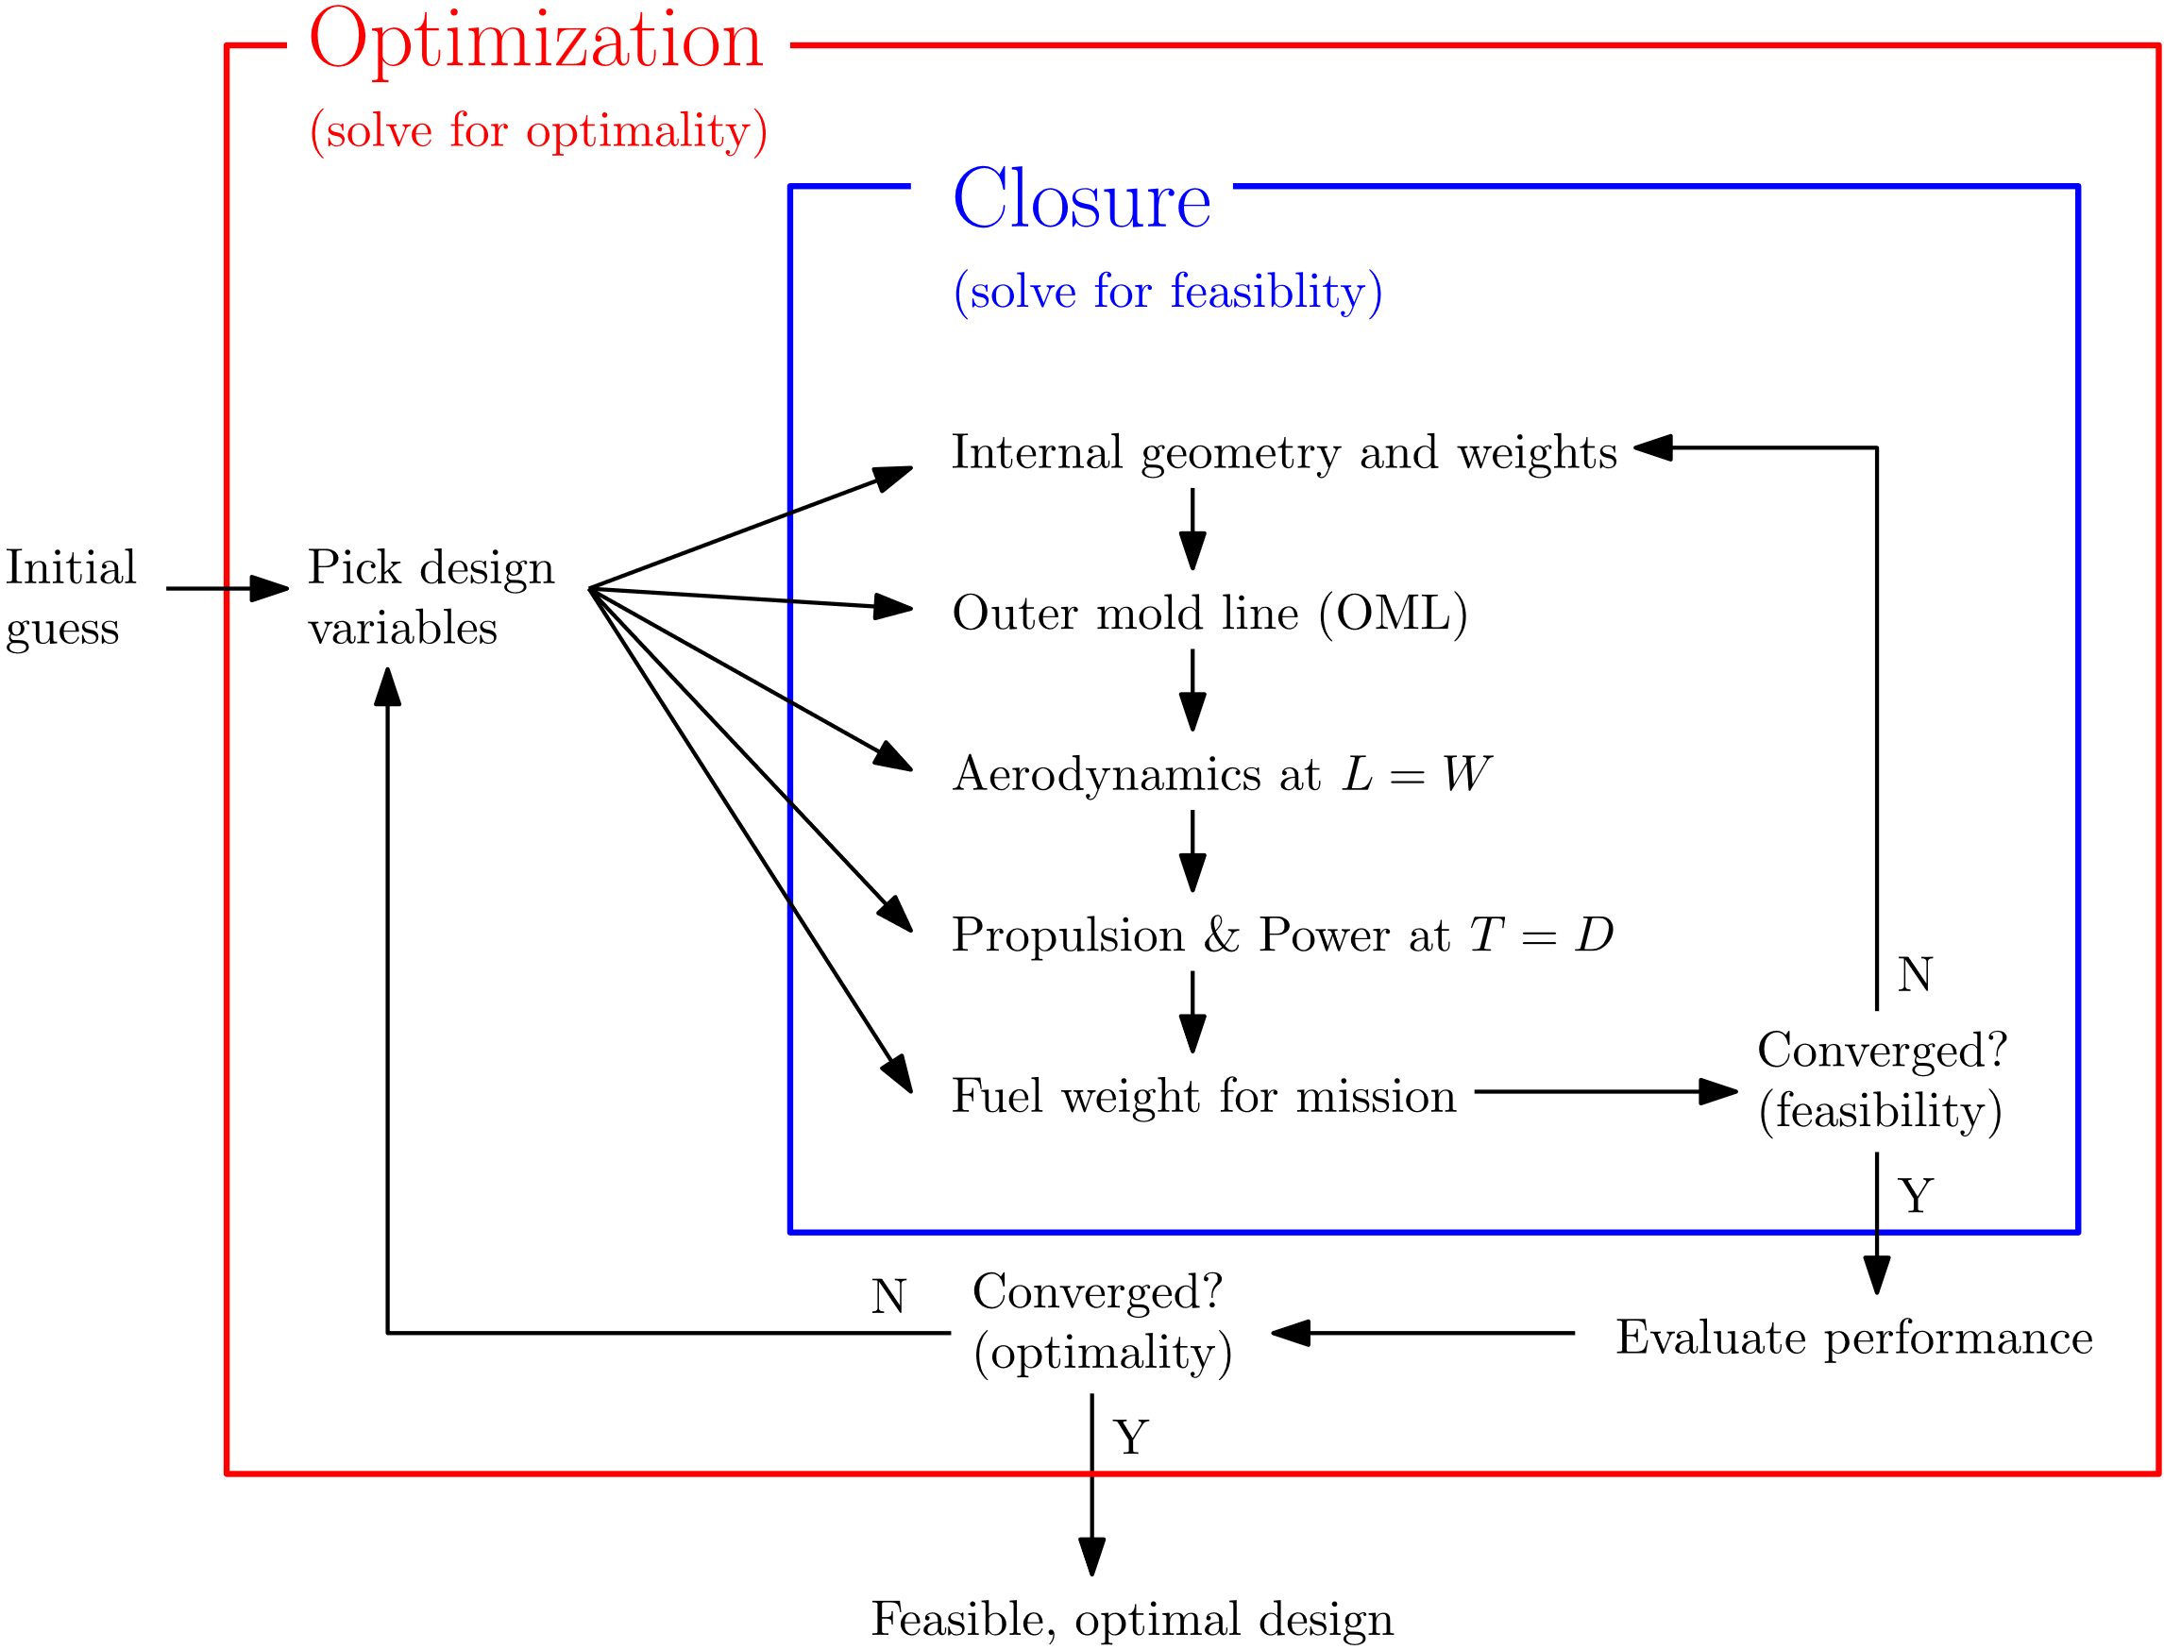
Coupled Problems: Approaches
Traditional: nested closure and optimization

Slide 37
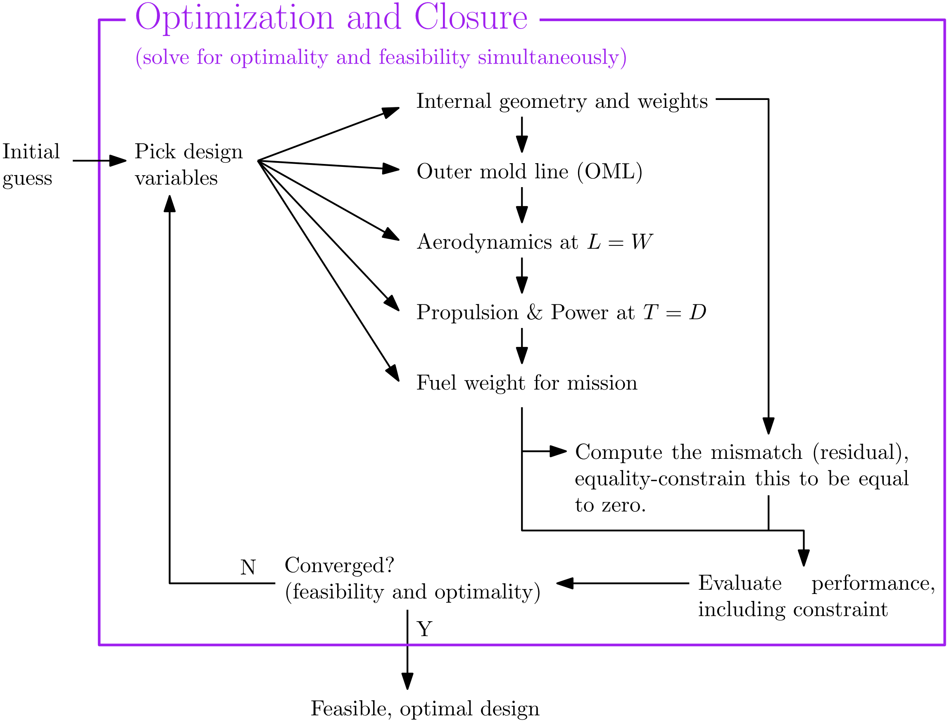
Coupled Problems: Approaches
More modern approach: simultaneous analysis and design (SAND)

Slide 38
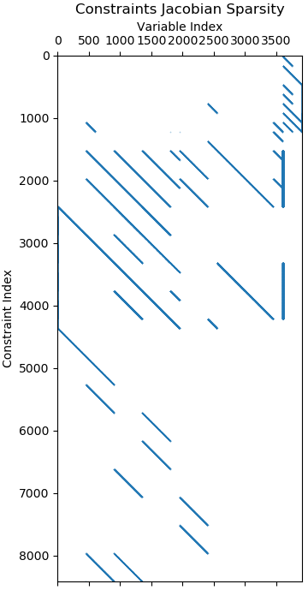

Coupled Problems: Is SAND worth it?
Eliminate an inner loop!
Early in optimization: why solve to perfect feasibility when you’re so far from optimal?
These are wasted CPU cycles!
Simple closure loop iteration can be numerically unstable.
Problem is larger (more variables) but sparser (less coupled)
Turns out: much faster, if you can exploit this
Other tricks:
Inequality constraints:
$L≥W$, not $L=W$
$T≥D$, not $T=D$
Result: SAND is 1-2 orders of magnitude faster. Why does speed matter?
Interactive design – configuration and sizing
A slow optimizer is not very useful for design
Notes:
So, note that now, our variables aren’t necessarily things we would consider to be “independent” – we have both structural sizing and weight!
Shifting our physics models into constraints
Use inequalities where possible
Limiting our cross-discipline couplings to just a few points
Figure on the right
Example of the jacobian of constraints with respect to design variables
Each “row” is a constraint, and the shaded regions show which variables are being linked by those constraints

Slide 39



High Dimensionality: Why is aircraft design so high-dimensional?
“High-dimensional”: many decision variables, many constraints.
Why is aircraft design so high-dimensional?
Many subsystems to track
OML parameterization
Smooth, curving surfaces are complicated functions in space
Trajectory parameterization
$h\left(t\right), α\left(t\right), γ(t)$, etc. are functions of time
Function space is infinite-dimensional

Slide 40

Perdix

Slide 41


3D Aerodynamics Methods
AeroBuildup: DATCOM-like method
Generalizes to arbitrary wing-body configurations
Vectorized across operating points
~5000 operating points / second
Viscous and compressible effects, nonlinear
Can optionally link to XFoil/MSES for sectional aerodynamics
Smooth, with sensible extrapolation to 360$°$ $α$, $β$ – suitable for optimization
Vortex Lattice Method
Nonlinear lifting line
Implicit; convergence against viscous sectional aerodynamics
Notes:
DATCOM
Collection of several dozen best-practices models
Some come from theory, others are fits to wind tunnel data and high-fidelity CFD from literature
Aero features
Low-Re CL and C_L-alpha changes
Transonic lift drop due to shock formation
Wing: On-the-fly, caching surrogate model developed from MSES

Slide 42

3D Aerodynamics Methods
Data from AeroBuildup Validation Study (Sailplane1)
In addition to forces/moments, methods give stability derivatives
3D, static and dynamic
Vectorized across mass properties (e.g., time dependent CG)
Validate well against existing low-fidelity tools (AVL)
All methods are differentiable, and AD is closed under differentiation, so for explicit methods we can directly apply stability constraints:
$C_{mα}≤−0.50$, $C_{nβ}≥0.05$, $C_{m}=0$
Shared API
Output | AeroBuildup | AVL | Significant Deviations?
CD | 0.02 | 0.01 | Expected
CL | 0.45 | 0.46
CLa | 6.30 | 6.07
CLq | 2.72 | 9.42 | *
CYb | -0.17 | -0.17
CYp | -0.36 | -0.22 | *
CYr | 0.10 | 0.12
Clb | -0.18 | -0.17
Clp | -0.72 | -0.64
Clr | 0.07 | 0.13 | *
Cm | 0.13 | 0.19
Cma | -1.69 | -0.95 | *
Cmq | -11.0 | -12.8
Cnb | 0.01 | 0.02
Cnp | -0.09 | -0.04
Cnr | -0.02 | -0.02
D | 29.5 | 11.7 | Expected
L | 805 | 815
m_b | 35.8 | 50.6
Notes:
Directly constrain stability derivatives
Higher order automatic differentiation

Slide 43


Flight Dynamics Engine
Modularity via abstraction:
Dimensionality: 1D, 2D, or 3D
Complexity (fastest relevant mode):
Steady (single-point)
Energy conservation (excess power)
Phugoid (airspeed)
Short-period ($α$, $β$)
Inertial ($p$, $q$, $r$, $δ_{e}$, $δ_{a}$, $δ_{r}$, $I$)
Newtonian or energy-based velocity parameterization
Integrator order: Euler, trapezoidal, Simpson, RK4 (WIP)
Shared API
Switchable with one line – move up and down the fidelity ladder

Slide 44


Flight Dynamics Engine
Modularity via abstraction:
Dimensionality: 1D, 2D, or 3D
Complexity (fastest relevant mode):
Steady (single-point)
Energy conservation (excess power)
Phugoid (airspeed)
Short-period ($α$, $β$)
Inertial ($p$, $q$, $r$, $δ_{e}$, $δ_{a}$, $δ_{r}$, $I$)
Newtonian or energy-based velocity parameterization
Integrator order: Euler, trapezoidal, Simpson, RK4 (WIP)
Vectorized, explicit or implicit (direct collocation)
Minimum-Altitude-Loss Trajectory for Cessna 152
With Engine INOP on Climbout, Downwind Approach

Slide 45


Development Tools for New Analyses
Differentiable Geometry and Meshing (various levels of degenerate geometry)
N-dimensional Splines for Structured or Unstructured Datasets

Slide 46


Other Composable Discipline-Specific Models
Probabilistic atmosphere, wind speed, and gust models
6-DoF Euler-Bernoulli Beam Models
Notes:
Differentiable thermodynamics library for jet engine cycle analysis
Propeller modeling
Electric & ICE motor models
Historical weight models for various aircraft components
Mass properties accounting and optimization w.r.t. these mass properties
2D airfoil panel method with IBL coupling (automatic-differentiable XFoil)

